Slide 1
(26Jun2020v3)
From candidate genes to causal variants: Strategies to identify (or not) genes and sequence variants in rodent populations
Webinar 4
Williams RW, Ashbrook DG, Mulligan MK, Lu L, Williams EG, Chen H, Prins J, Saba LM, Sen S, Sloan Z, Centeno A, and the P30 and GN teams
Sponsored by the NIDA Center of Excellence in Omics, Systems Genetics, and the Addictome (NIDA P30 DA044223), with support from NIGMS Systems Genetics and Precision Medicine Project (R01 GM123489)
Presented by Rob Williams rwilliams@uthsc.edu

Slide 2
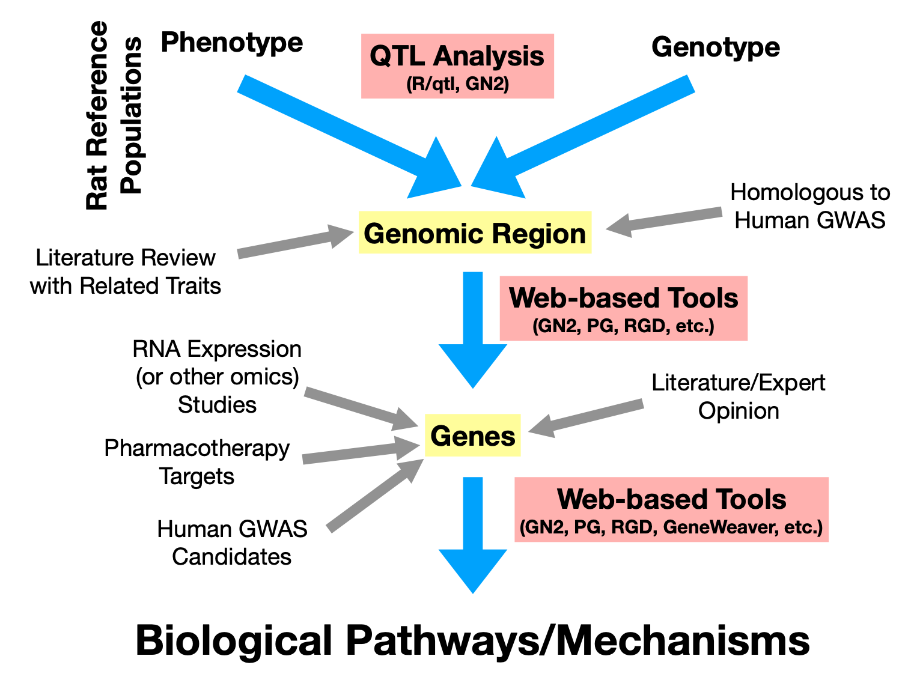
Where to find the presentations in this series
OPAR.io
1
Mapping resources and comparisons
When is it practical or not to define genes and causal variants associated with loci? Key factors: Map precision, genetic complexity of locus (numbers of variants and genes in interval), robustness and GXE sensitivity
Classic forward genetic methods that have worked, but almost always with a caveat or two. QT nucleotide are icing-on-cake, not essential for mechanistic or tranlational studies.
New reverse genetic methods and phenome-wide association studies (PheWas). Epoch effects as a hybrid methods (forward and reverse)
Demo of some ways to cherry pick. (1) Finding strong loci worth converting to gene variants. (2) Finding impactful variants worth converting to phenotypes
2
3
4
5
Slide 2: OPAR.io for presentations and omics data for addictome research

Slide 3
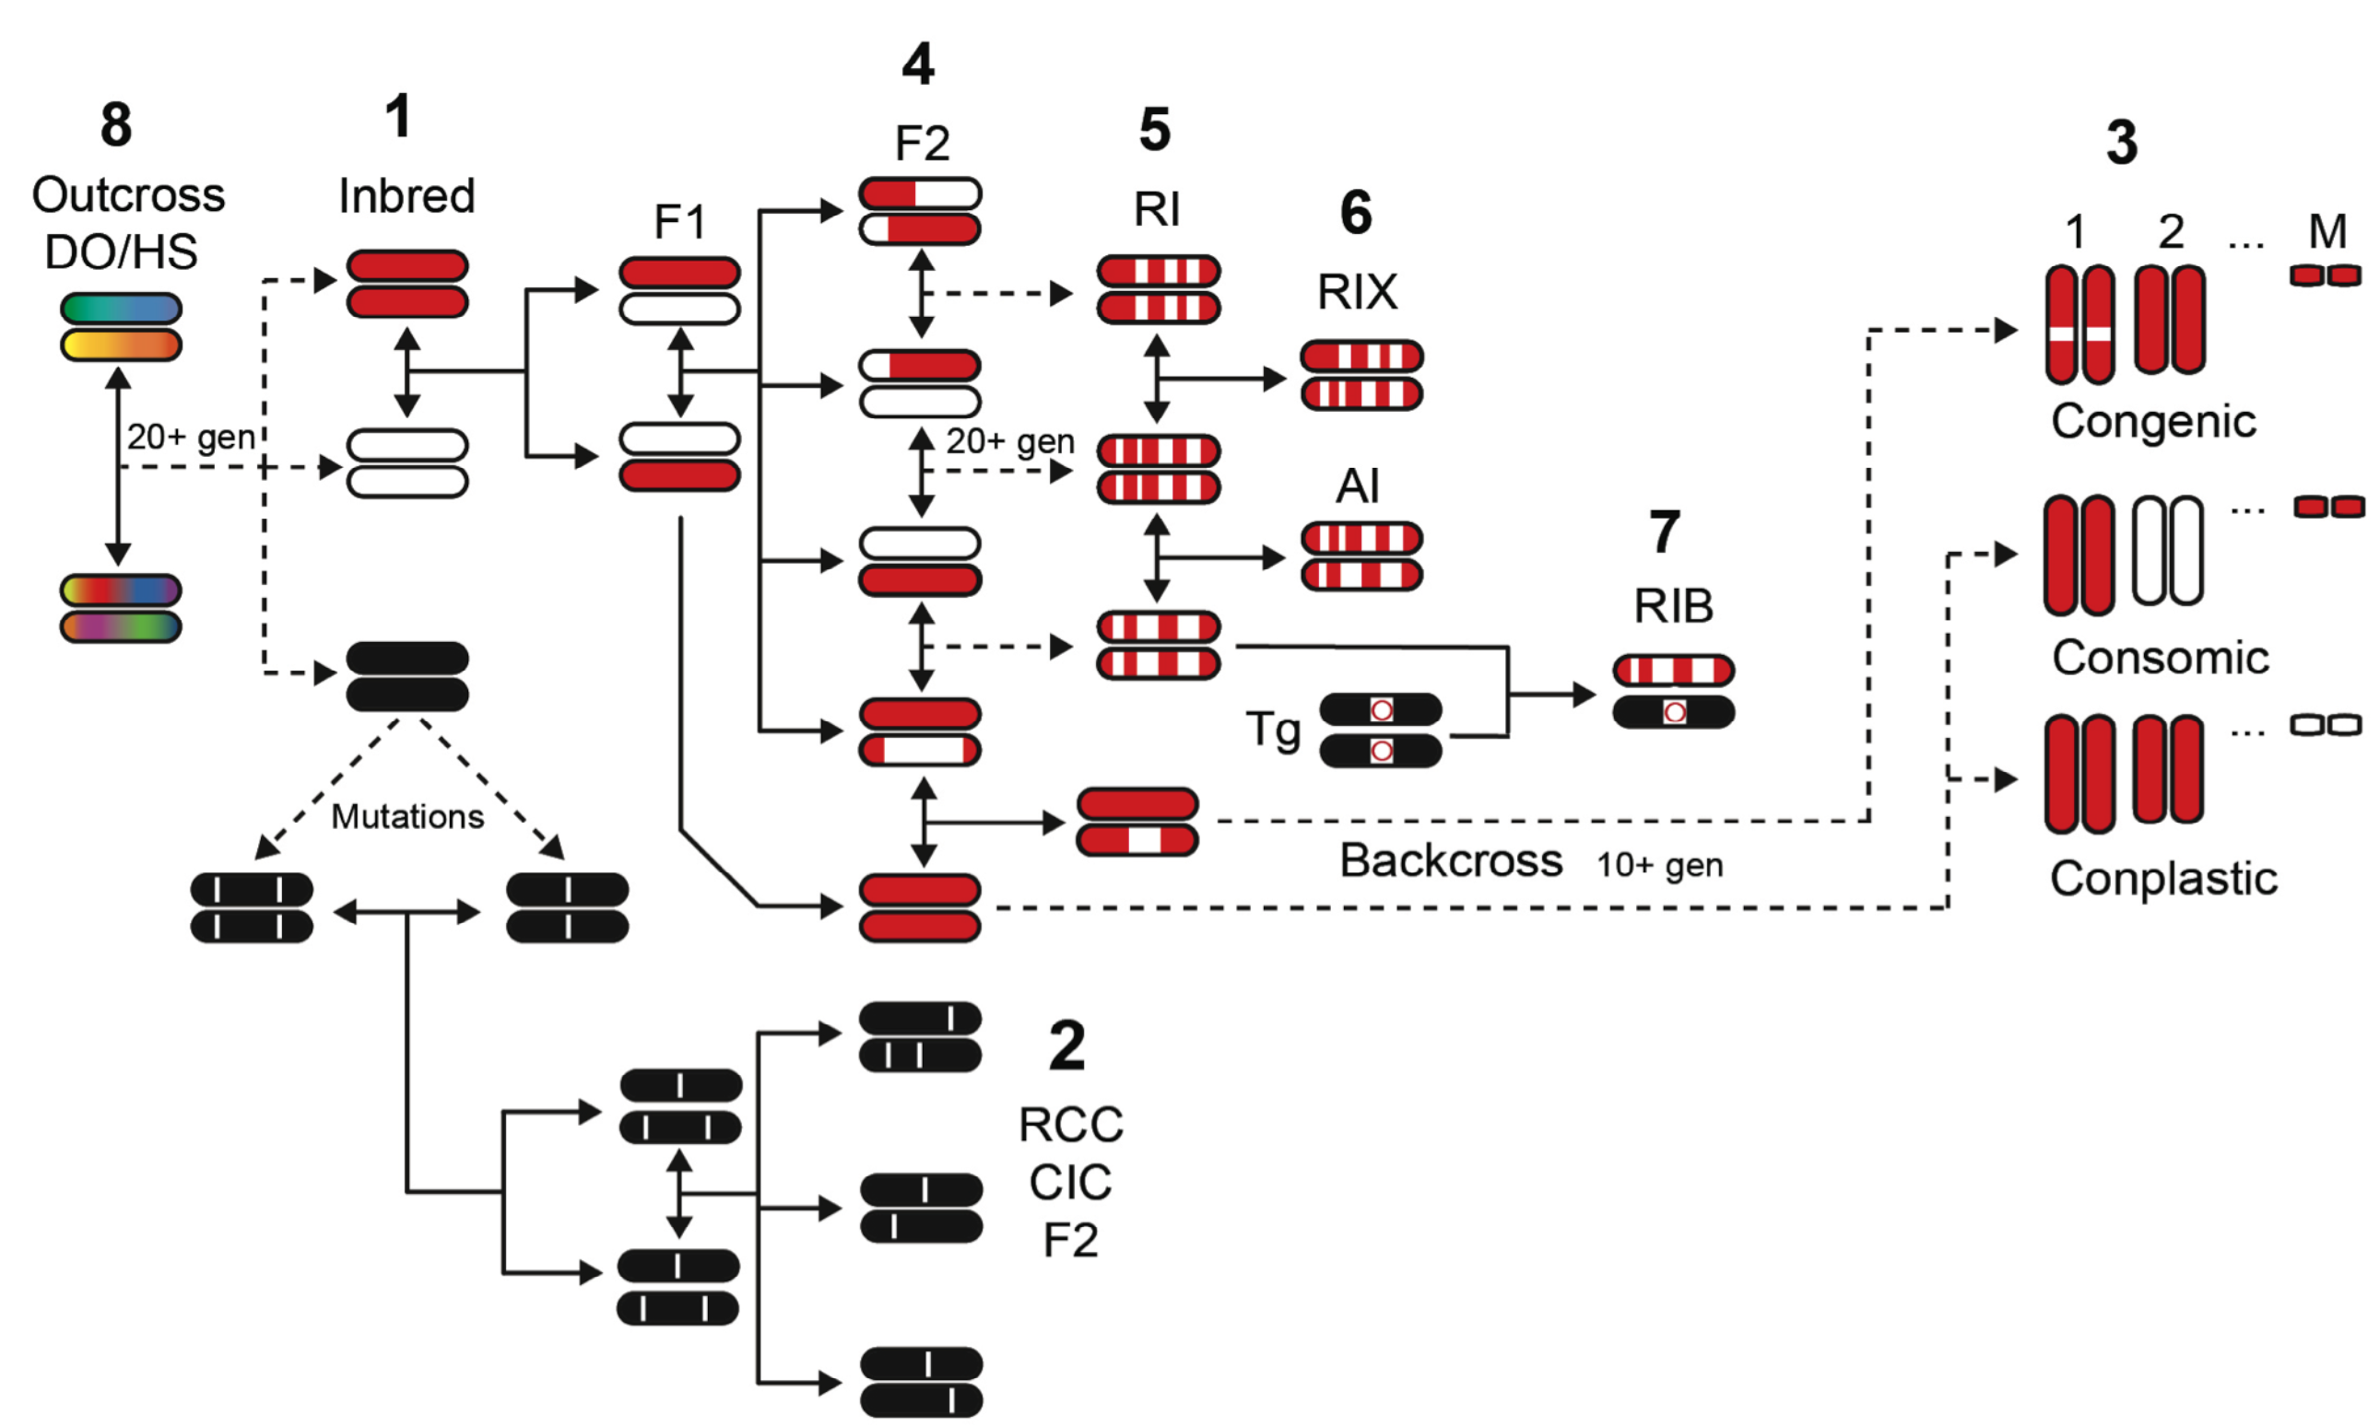
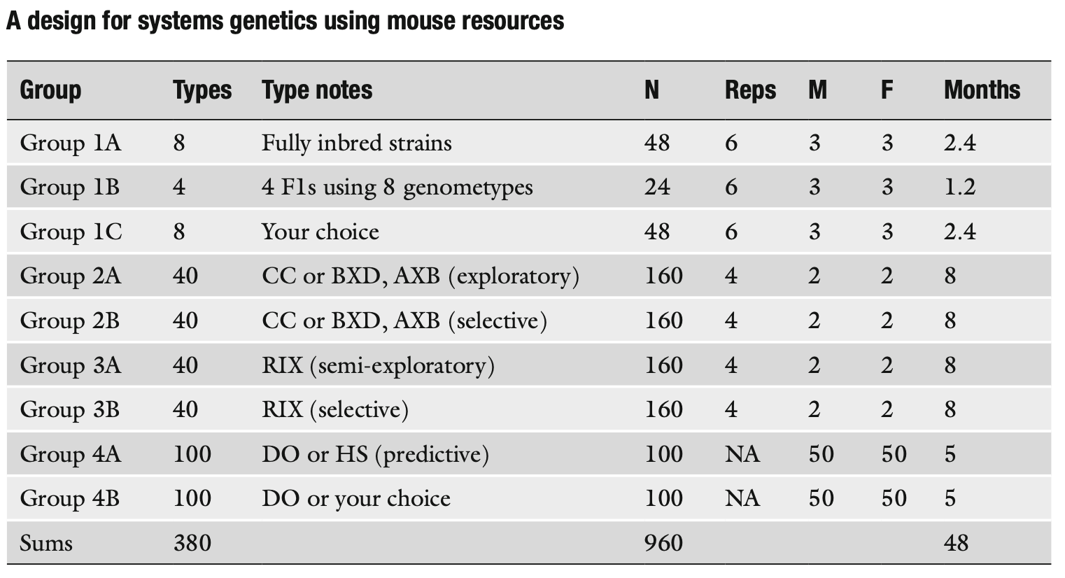
Main types of mapping resources
Williams RW, Williams EG (2017) Resources for Systems Getnetics. Systems Genetics: Methods and Protocols, Methods in Molecular Biology, vol. 1488: 3–29
Part 1: Slide 3

Slide 4
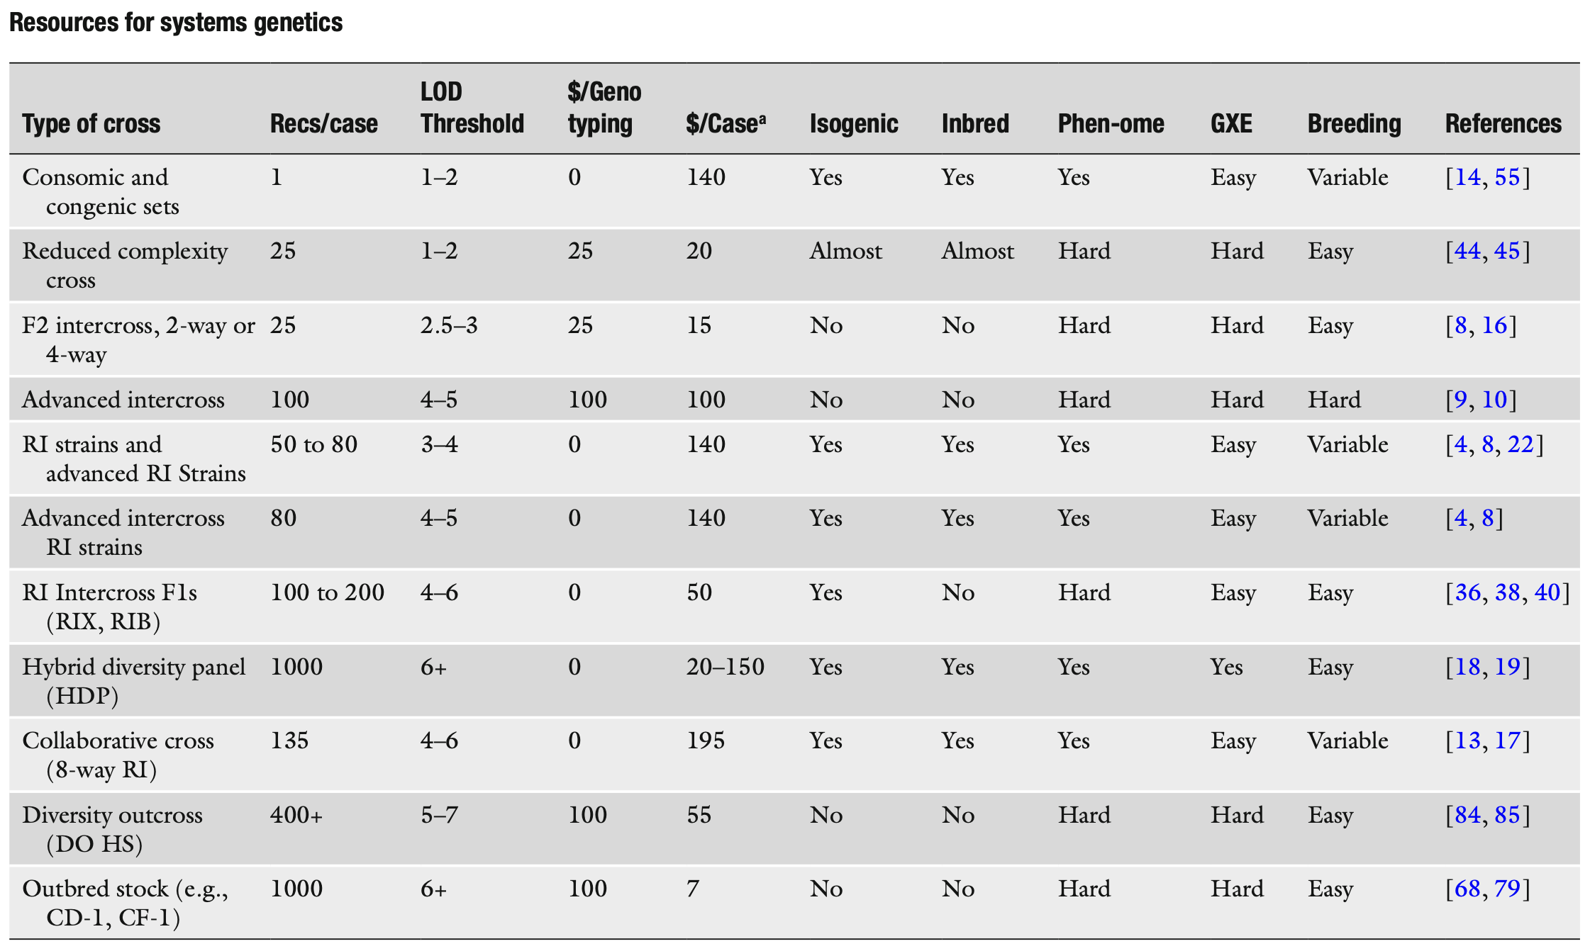
Some comparisons of resources
Williams RW, Williams EG (2017) Resources for Systems Getnetics. Systems Genetics: Methods and Protocols, Methods in Molecular Biology, vol. 1488: 3–29
Part 1: Slide 4

Slide 5
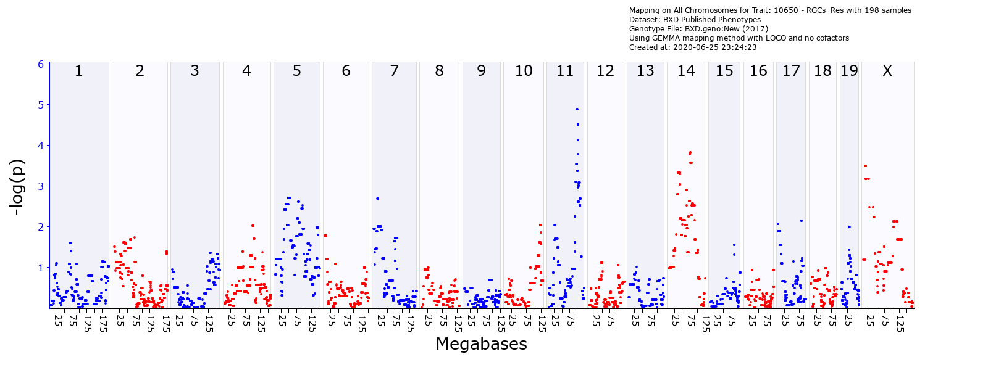
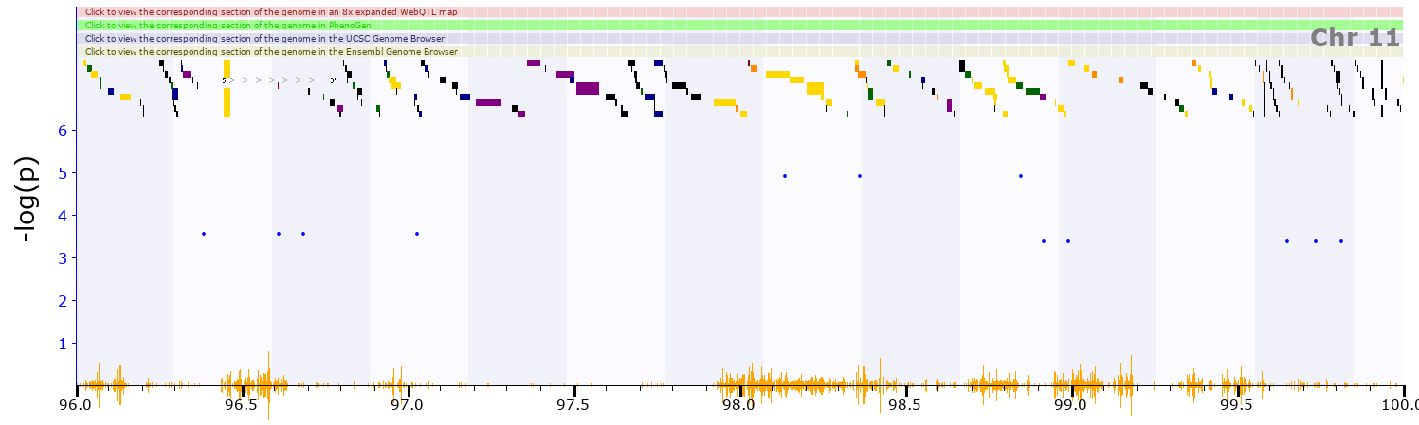
Strategies to improve chances of defining causal genes
1
Maximize the effective precision by reducing the product of [QTL length] X [n of polymorphics genes and DNA variants]. 10 Mb can be great effective precision if there are few variants or genes (see Comt example to follow). Conversely, 2 Mb can be problematic if a regions is very gene-rich and polymorphic.
This is a small interval: about 2.0 Mb
but has very high gene density. Ouch.
genenetwork.org/show_trait?trait_id=10650&dataset=BXDPublish
Part 2: Slide 5

Slide 6
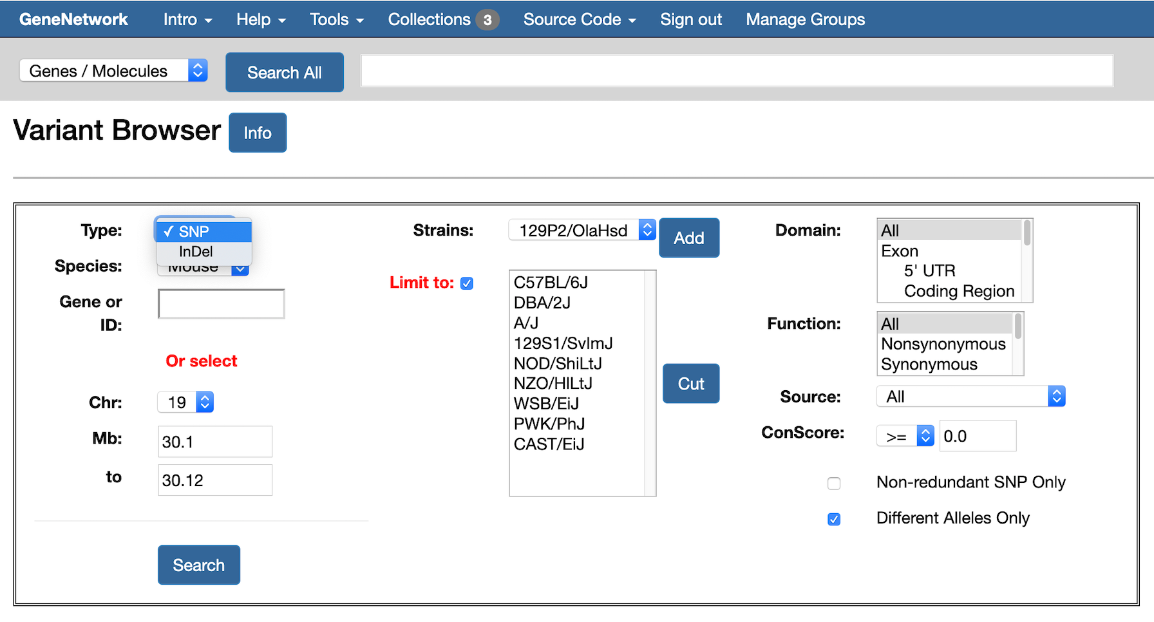
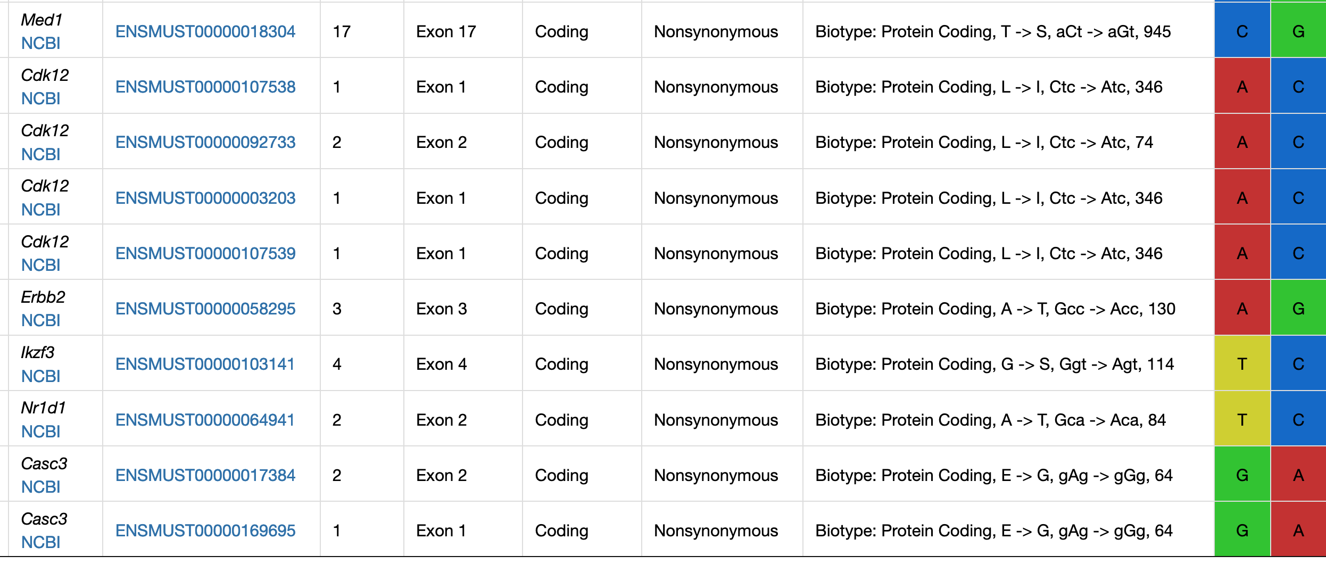
Strategy 2
2
Maximize your use of sequence data and eQTL data. There are only two major ways a DNA variant can operate—protein-coding variants and isoform expression level variatiants. This seems painfully obvious, but if it is so obvious then why are rat and mouse sequence data still so sadly incomplete? Why are there not validated compendia of sequence variants segregating in major crosses? Where are the all of the great data on splice isoforms in brain or other tissues and cells? Why are maps still expressed in centiMorgans rather than basepairs?
Part 2: Slide 6

Slide 7
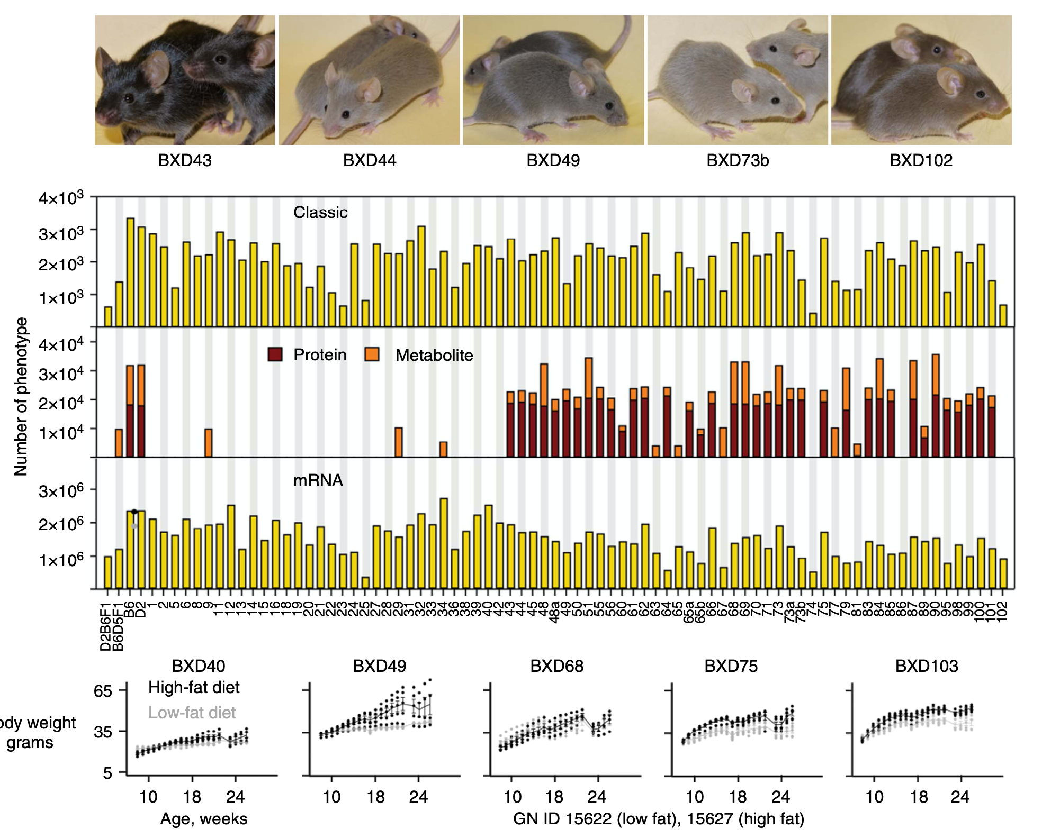
Strategy 3
3
Study populations for which you can generate or inherit a deep phenome. Use either reference populations or work as part of a larger collaboration. HRDP, HMDP, HS, CC, BXDs—all of these work well from this perspective.
When possible get complementary omics data, and if at all possible, biobank tissues.
The power of replicability can be huge when heritability is low. We have strong lifespan loci with only 70 BXD strains, but 10 replicates of each. Replicability also enables GXE analysis.
While all of this is obvious, it goes against the grain of ”doing your own thing” and being innovative.
Part 2: Slide 5
NATURE COMMUNICATIONS | 7:10464 | DOI: 10.1038/ncomms1046

Slide 8
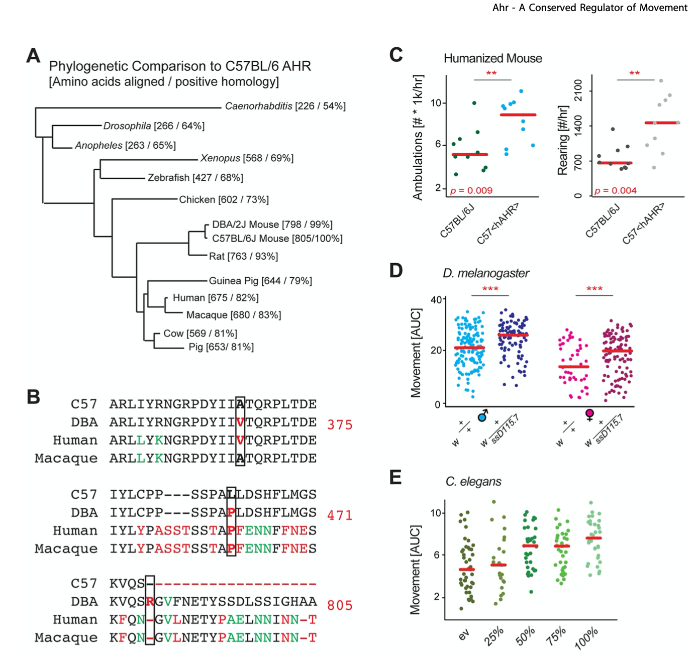
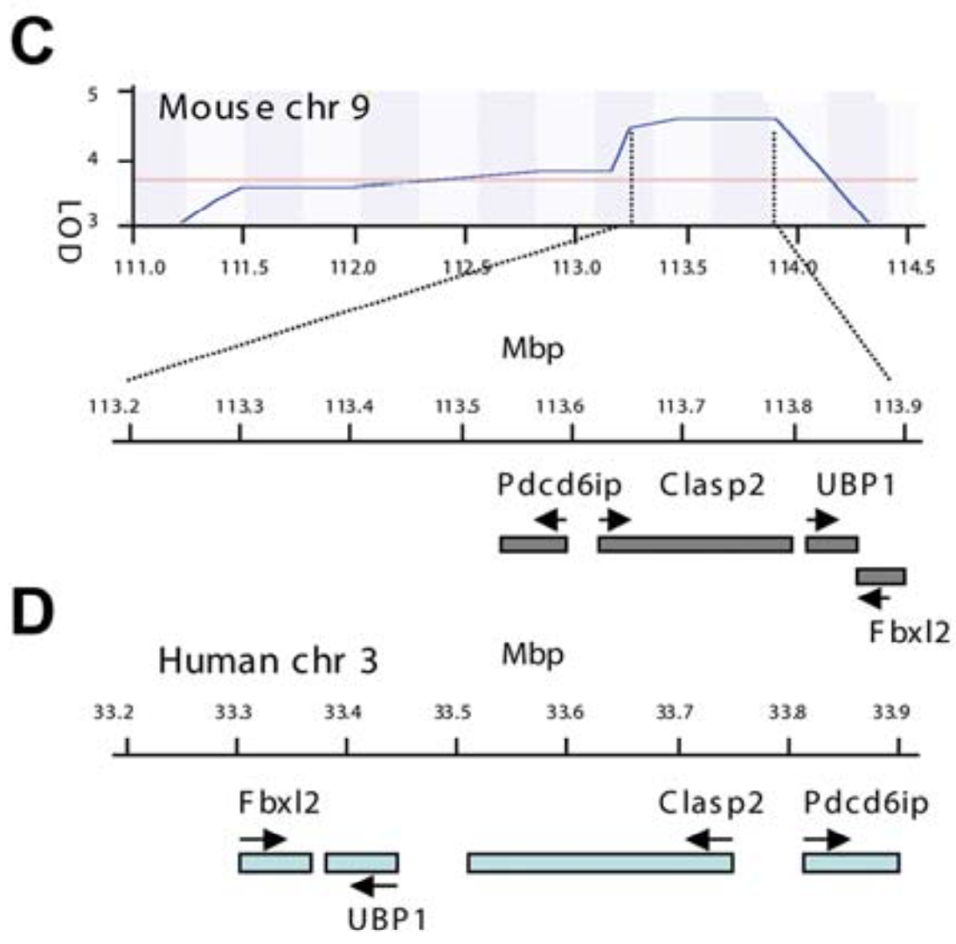
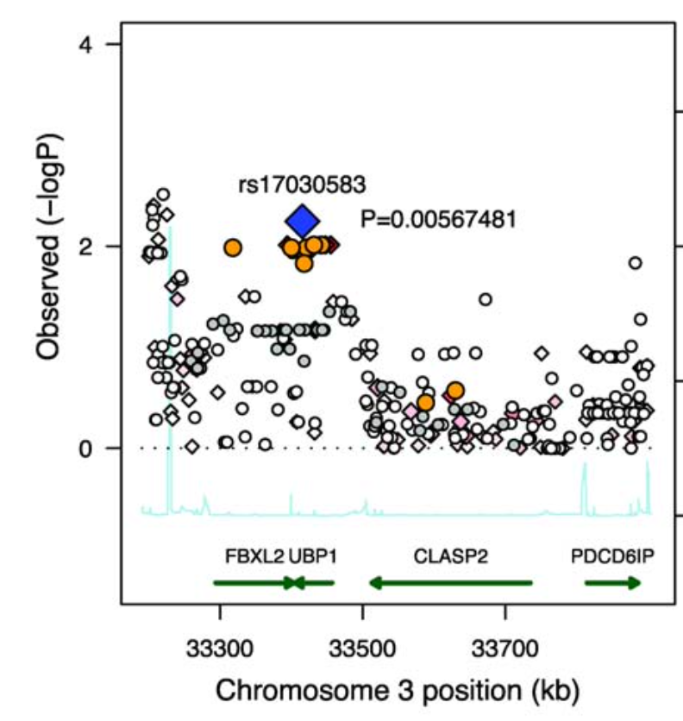
Strategy 4
4
Use multiple crosses and mulitple species to “fine-map” loci that modulate trait values or variance.
Part 2: Slide 7

Slide 9
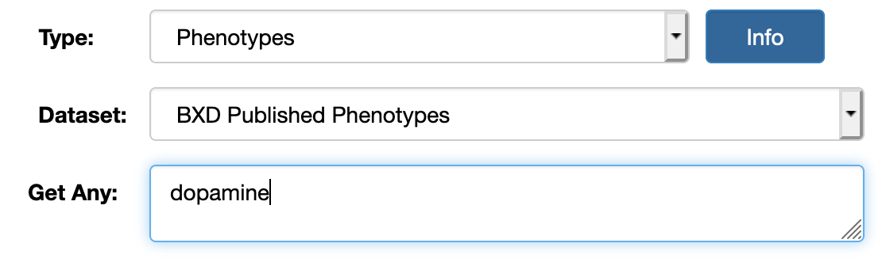
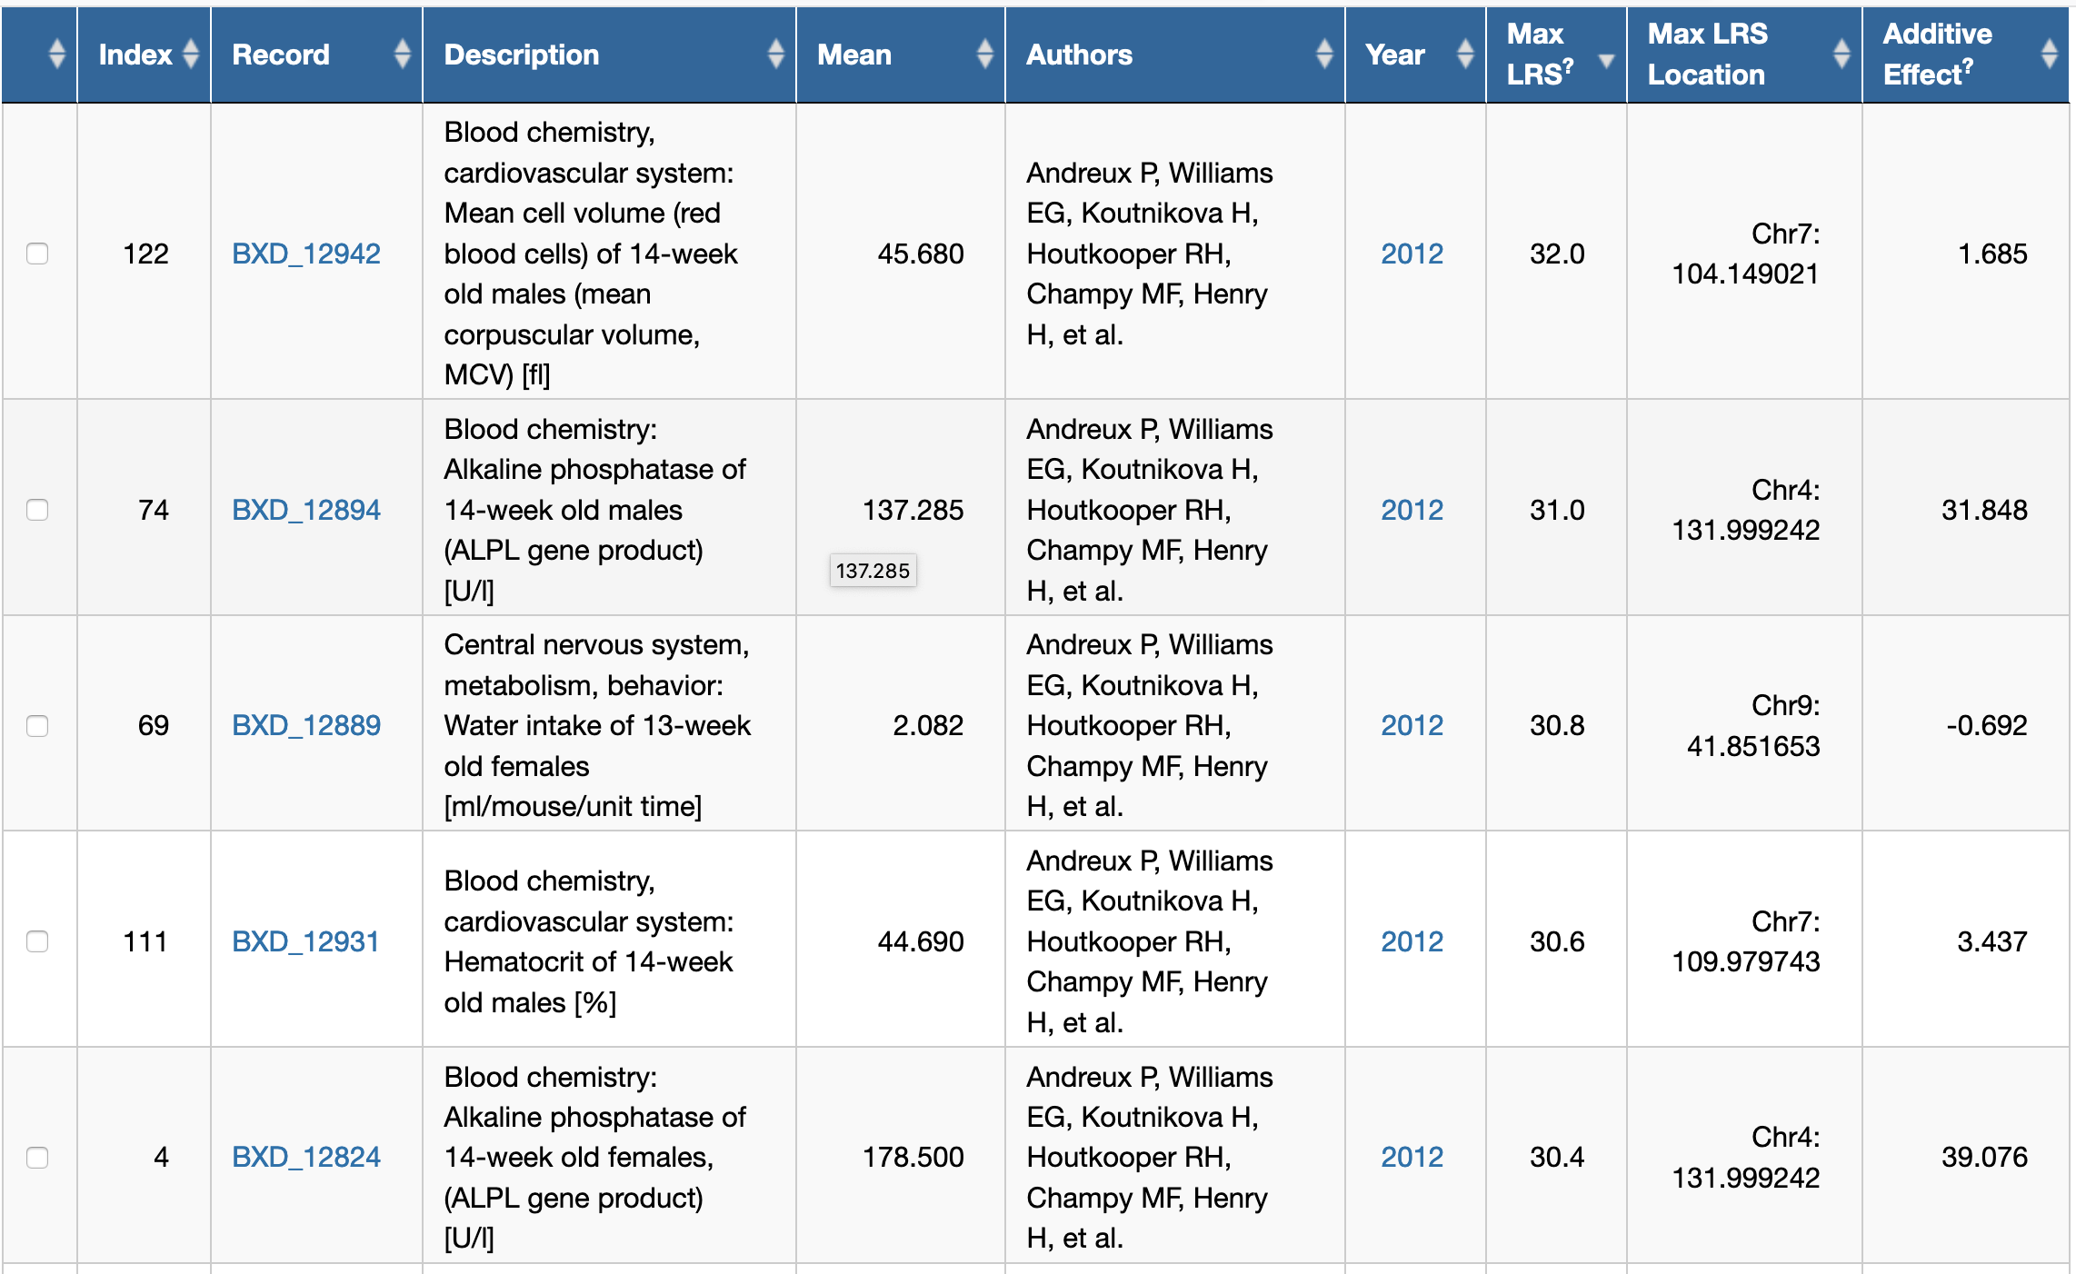
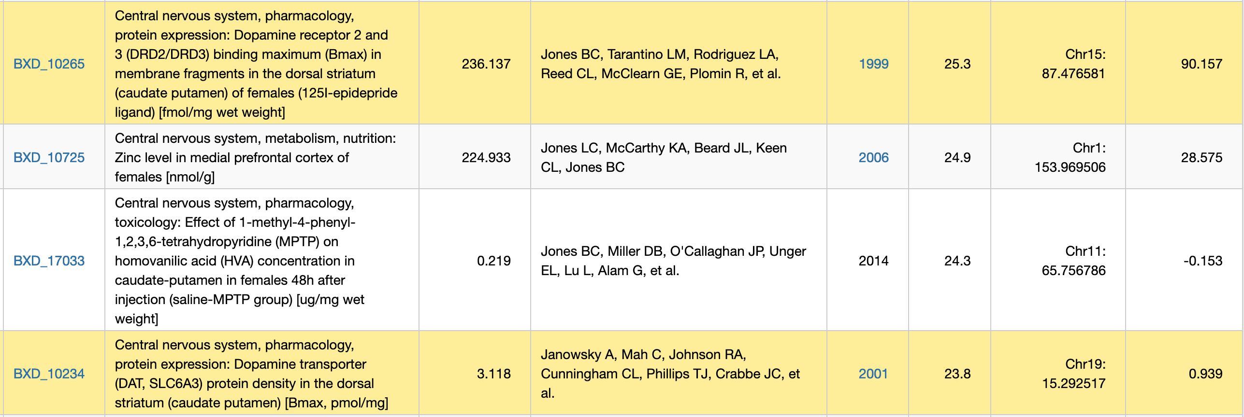
Strategy 5
5
Study molecular endophenotypes. They tend to be eaiser to measure, may have less complex genetic architecture, often have known partners and pathways, and can be easier clone and put into a mechanistic context.
Part 2: Slide 9

Slide 10
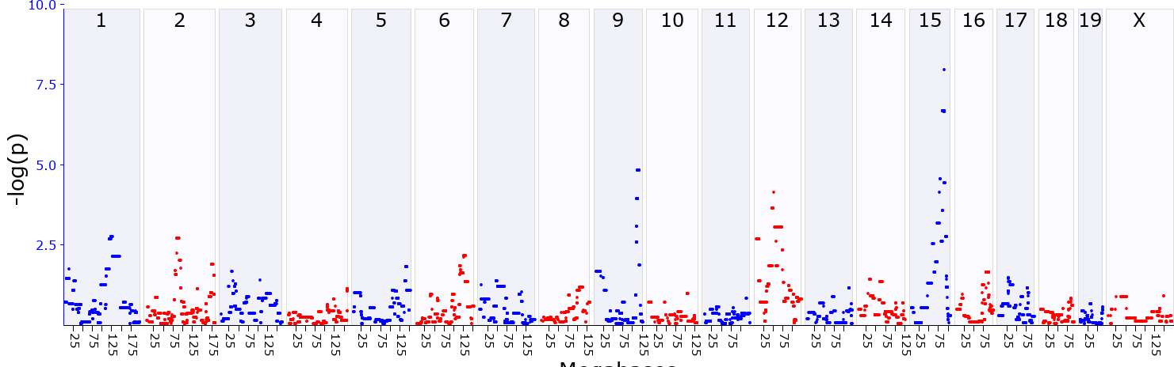
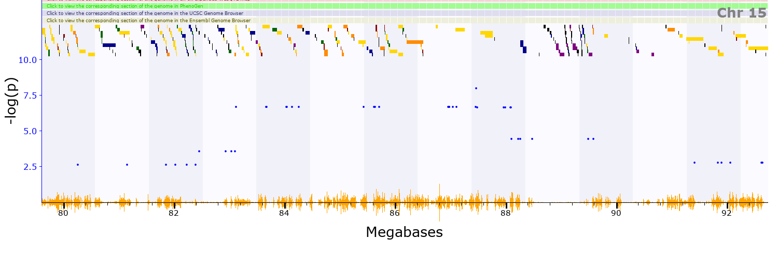
Does strategy 5 work?
Ataxin 10 has very high expression in MSN in striatum
Ataxin 10 is a strong cis eQTL in striatum
Ataxin 1 reported to modulate Drd2 expression in cerebellum
–log9(p) of 7.9, Chr 15 and 87 Mb
Part 3: Slide 10 Classic forward methods

Slide 11
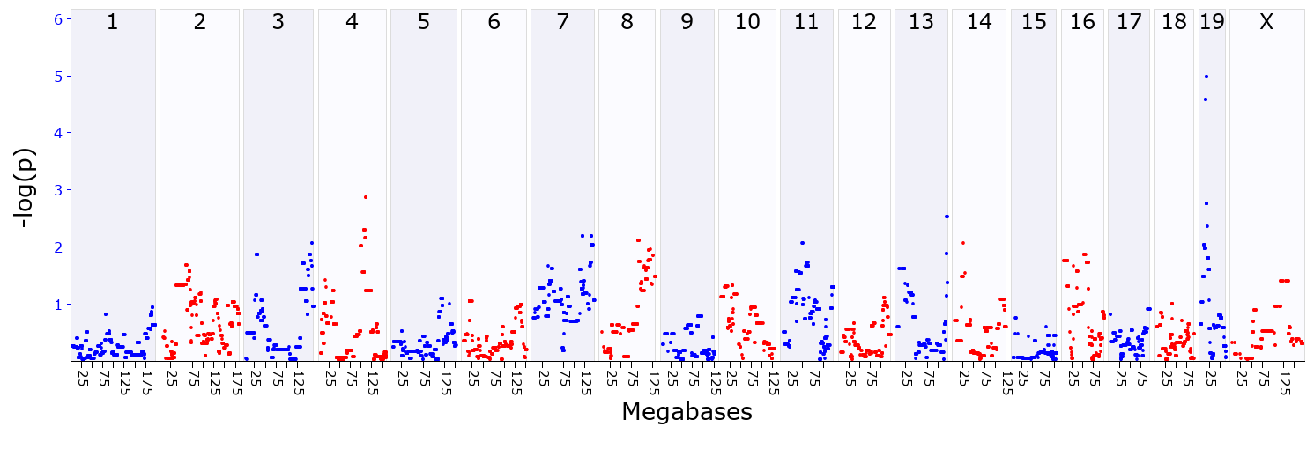
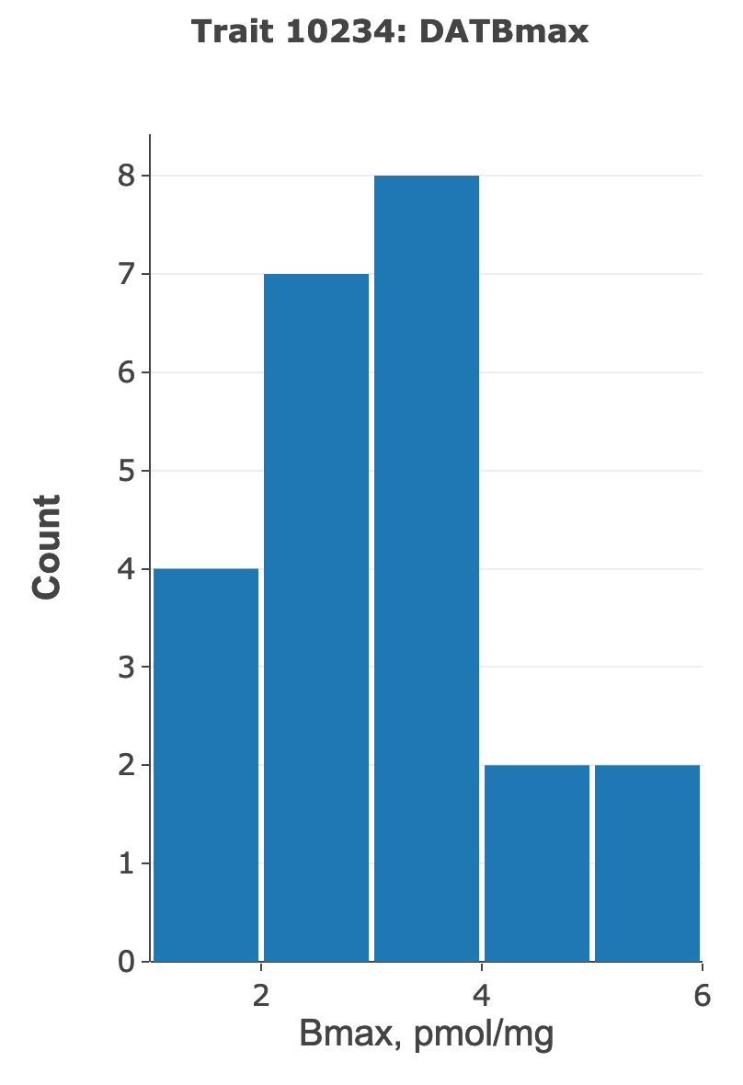
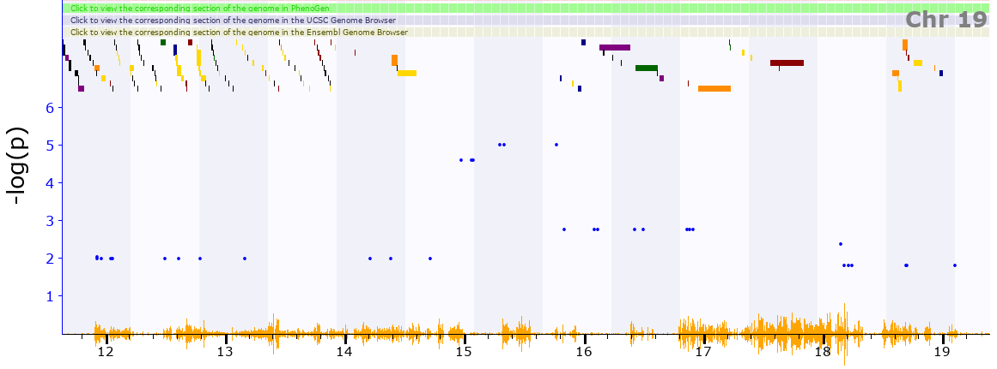
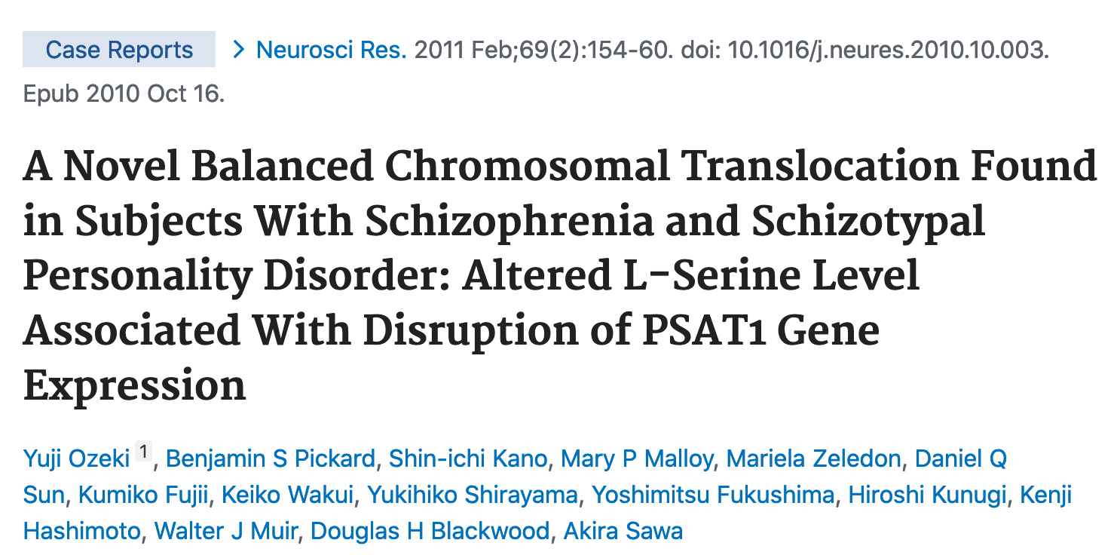
Try strategy 5 with 2nd trait
The Slc6a3 gene (DAT) is located on Chr 13 at 73.6 Mb, but DAT protein activity maps to Chr 19 at 15–16 Mb with a –log(p) of 5.0.
Psat1 is almost the only candidate in this gene sparse region.
genenetwork.org/show_trait?trait_id=10234&dataset=BXDPublish
Part 3: Slide 11 Classic forward methods

Slide 12
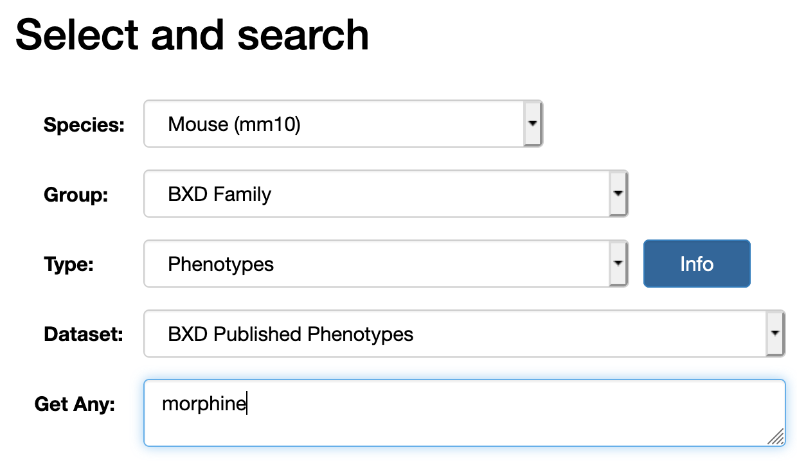
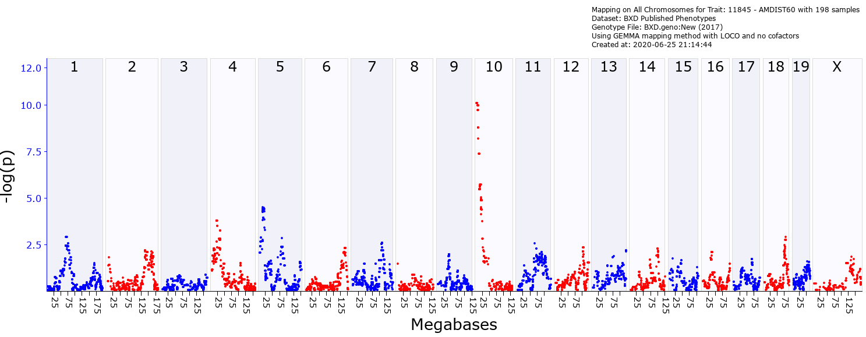
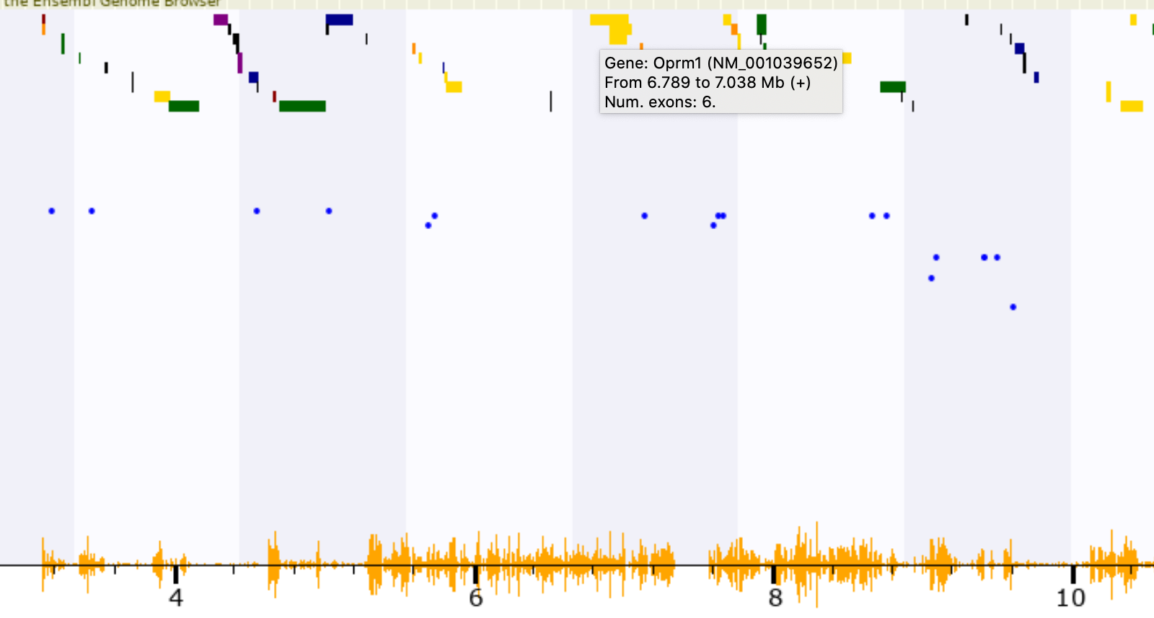
When is it practical to identify an almost “sure thing” candidate gene
Serendipity: A strong correspondence between well understood biology and known functions of a candidate gene.
Risk is narrative potenial again
The orange hash on the x-axis indicates the SNP density in an interval. Oprm1 regions is loaded.
This is a large interval
Part 3: Slide 12

Slide 13
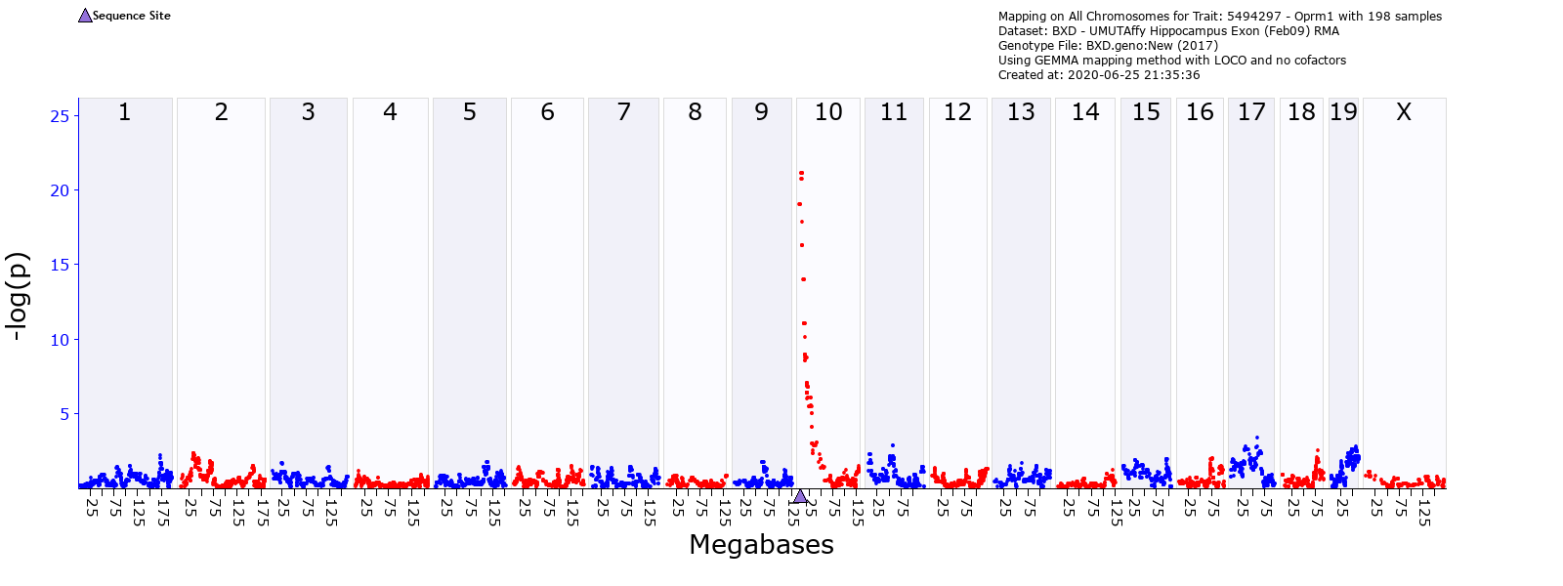
Oprm1 has multiple strong cis eQTLs in relevant brain regions
The bad news is finding THE causal nucleotide variants associated with Oprm1 cis eQTLs is impractical because there are almost certainly multiple variants between B and D haplotypes at work.
Part 3: Slide 13

Slide 14
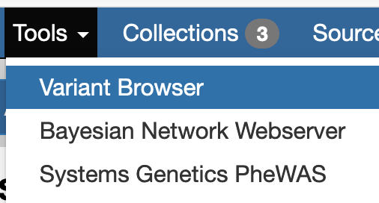
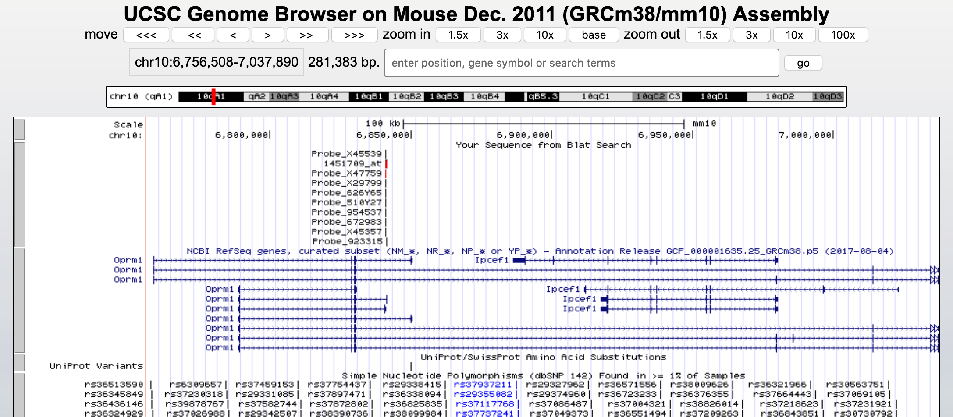
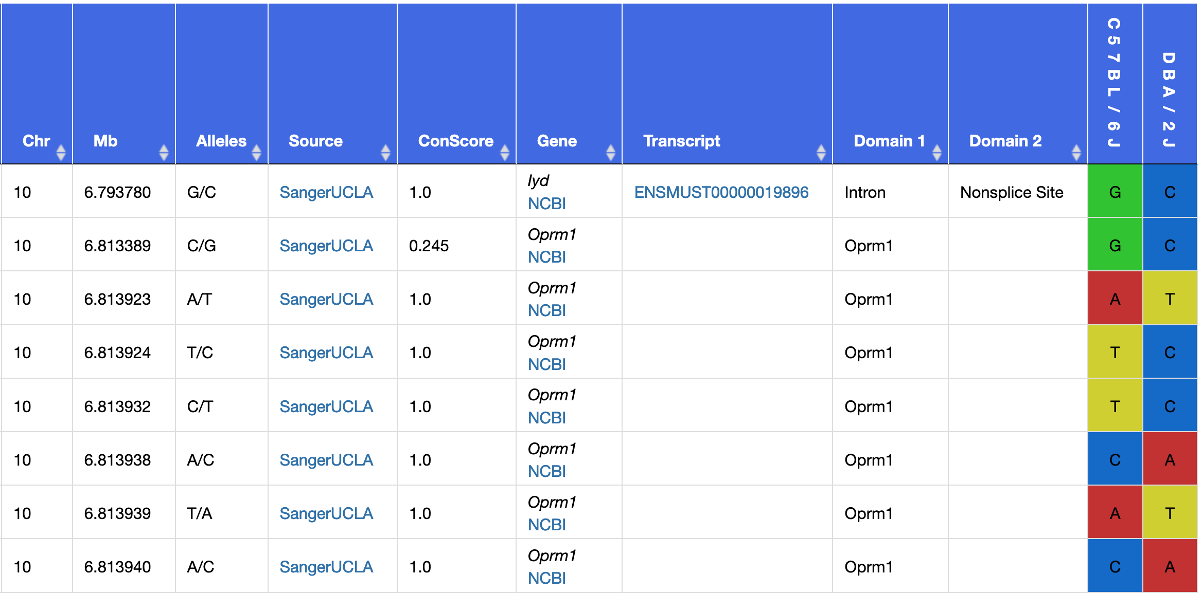
Oprm1 has no known missense variants
Oprm1
cis eQTL
Oprm1 has no known mis-sense variants or small indels between B and D haplotypes
Oprm1 in Genome Browser
Part 3: Slide 14

Slide 15
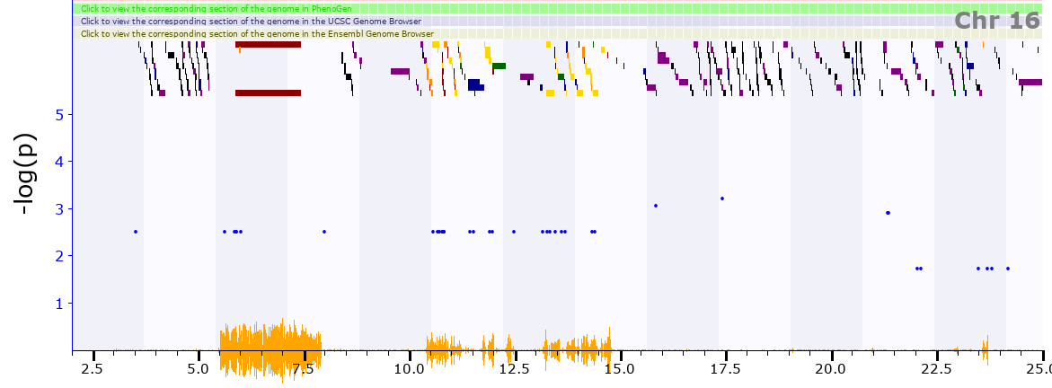
When is it practical to identify a single DNA variant?
Rarely—even in rodent models and in GWASs with high precision. Most successes are NOT pure forward genetic studies, but rely on known and rare sequence variants and reverse genetic methods. Examples include a B2 SINE in Comt and a deletion in Gabra2—both in the “wildtype” B6 mouse strains (Mulligan and colleagues, 2012, 2019)
genenetwork.org/show_trait?trait_id=10252&dataset=BXDPublish
Oddly the interval is IBD
Part 4: Slide 15 Reverse genetics

Slide 16
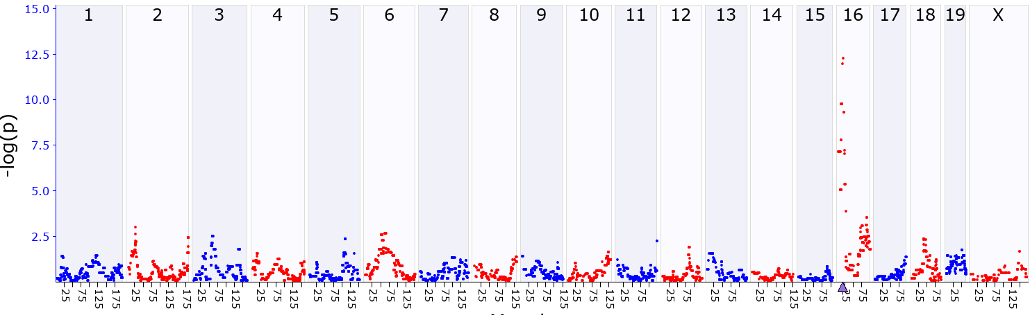
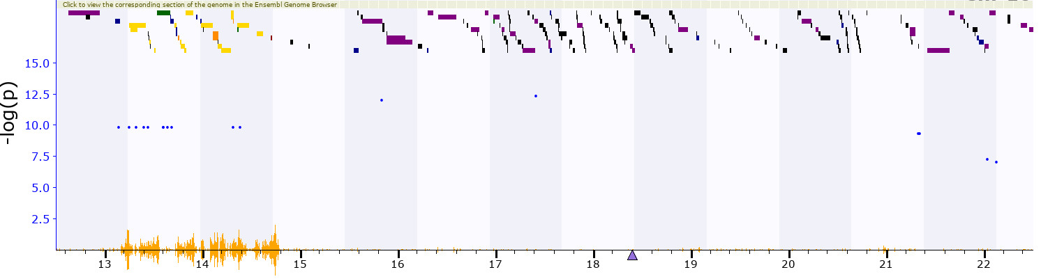
Part 3: Reverse Genetics and PheWAS
Comt is a strong cis eQTL despite being in the middle of an IBD region
Serendipity again: The Chr 16 QTL D1R binding contains the catechol-O-methyltransferase gene (Comt)
Comt transcript cis eQTL
genenetwork.org/show_trait?trait_id=1418701_at&dataset=SA_M2_0405_RR
genenetwork.org/show_trait?trait_id=10252&dataset=BXDPublish
But this interval is IBD.
What variant could generated this cis eQTL?
Part 4: Slide 16 Reverse genetics

Slide 17
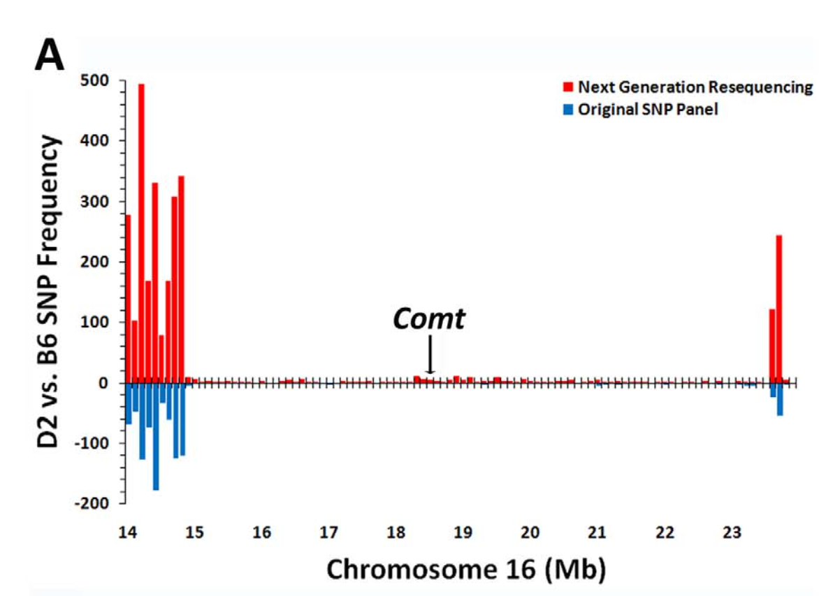
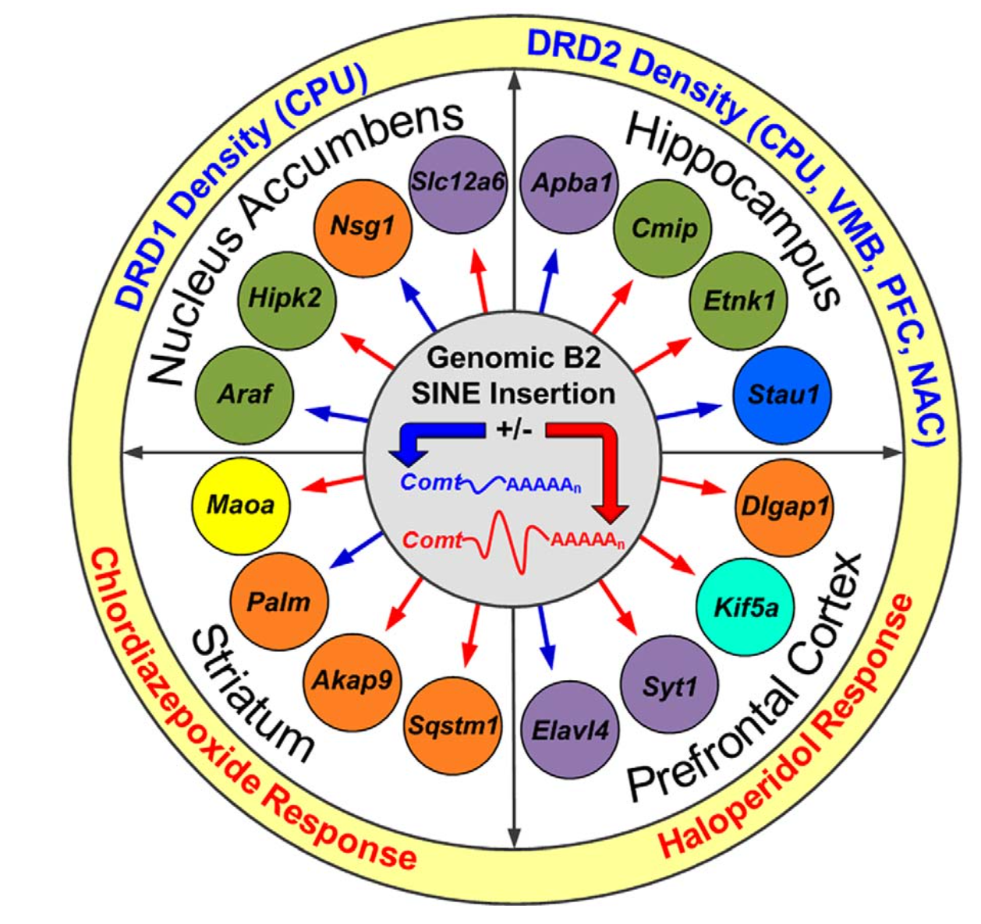
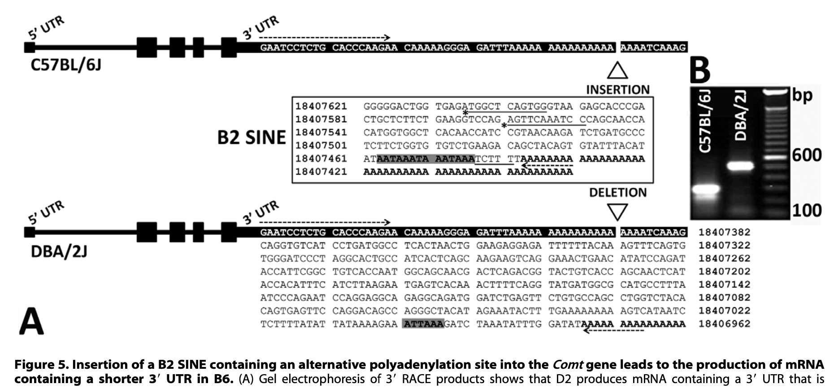
Part 3: Reverse Genetics and PheWAS
FAIR data:
Start of a multiscalar phenome
Find
Access
Interoperate
Reuse/Replicate
2010
Part 4: Slide 17 or Experimental PheWAS

Slide 18
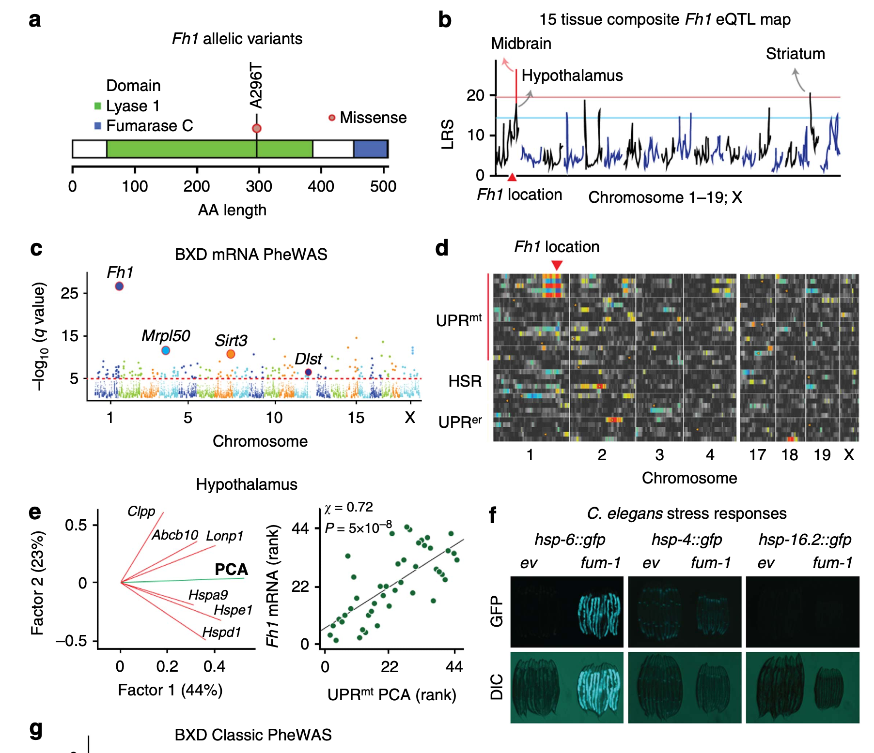
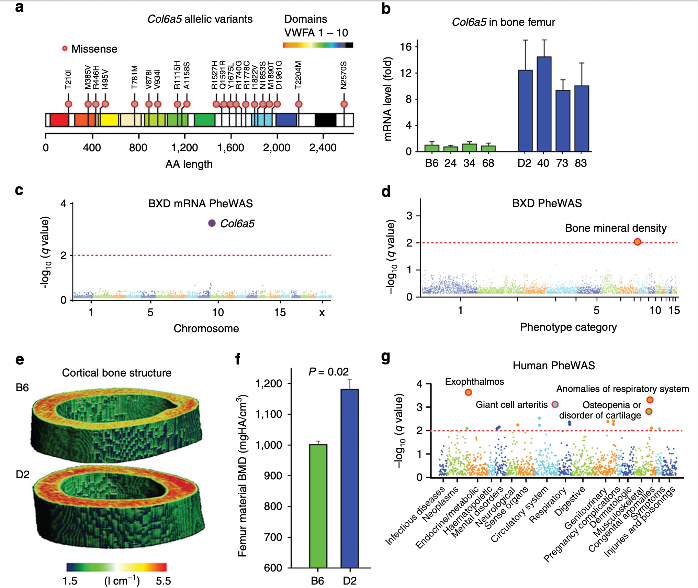
Two problems: Generating a phenome
and seeing through the LD
Part 4: Slide 18: PheWAS in rodents requires a phenome

Slide 19
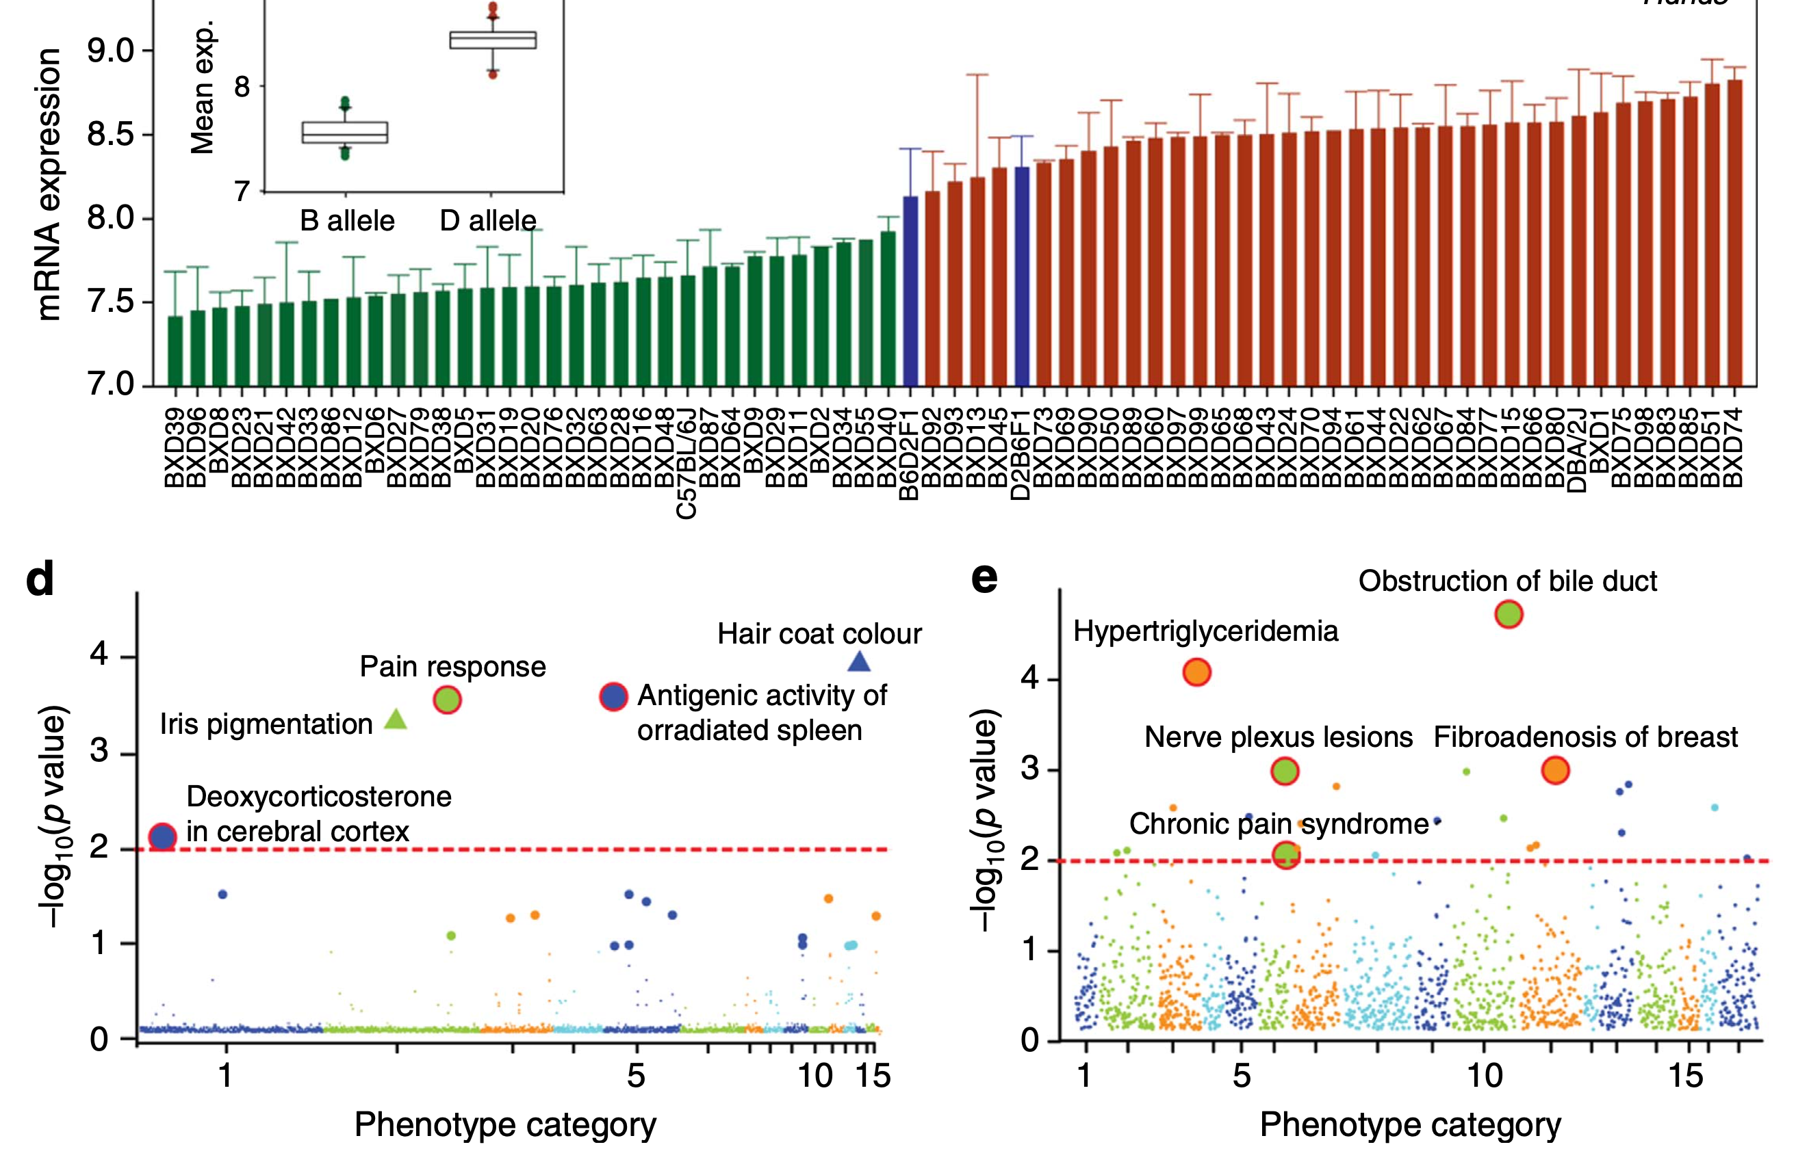
AHR PheWAS in mouse and human (BioVU, Josh Denny and team)
Part 4: Slide 19

Slide 20
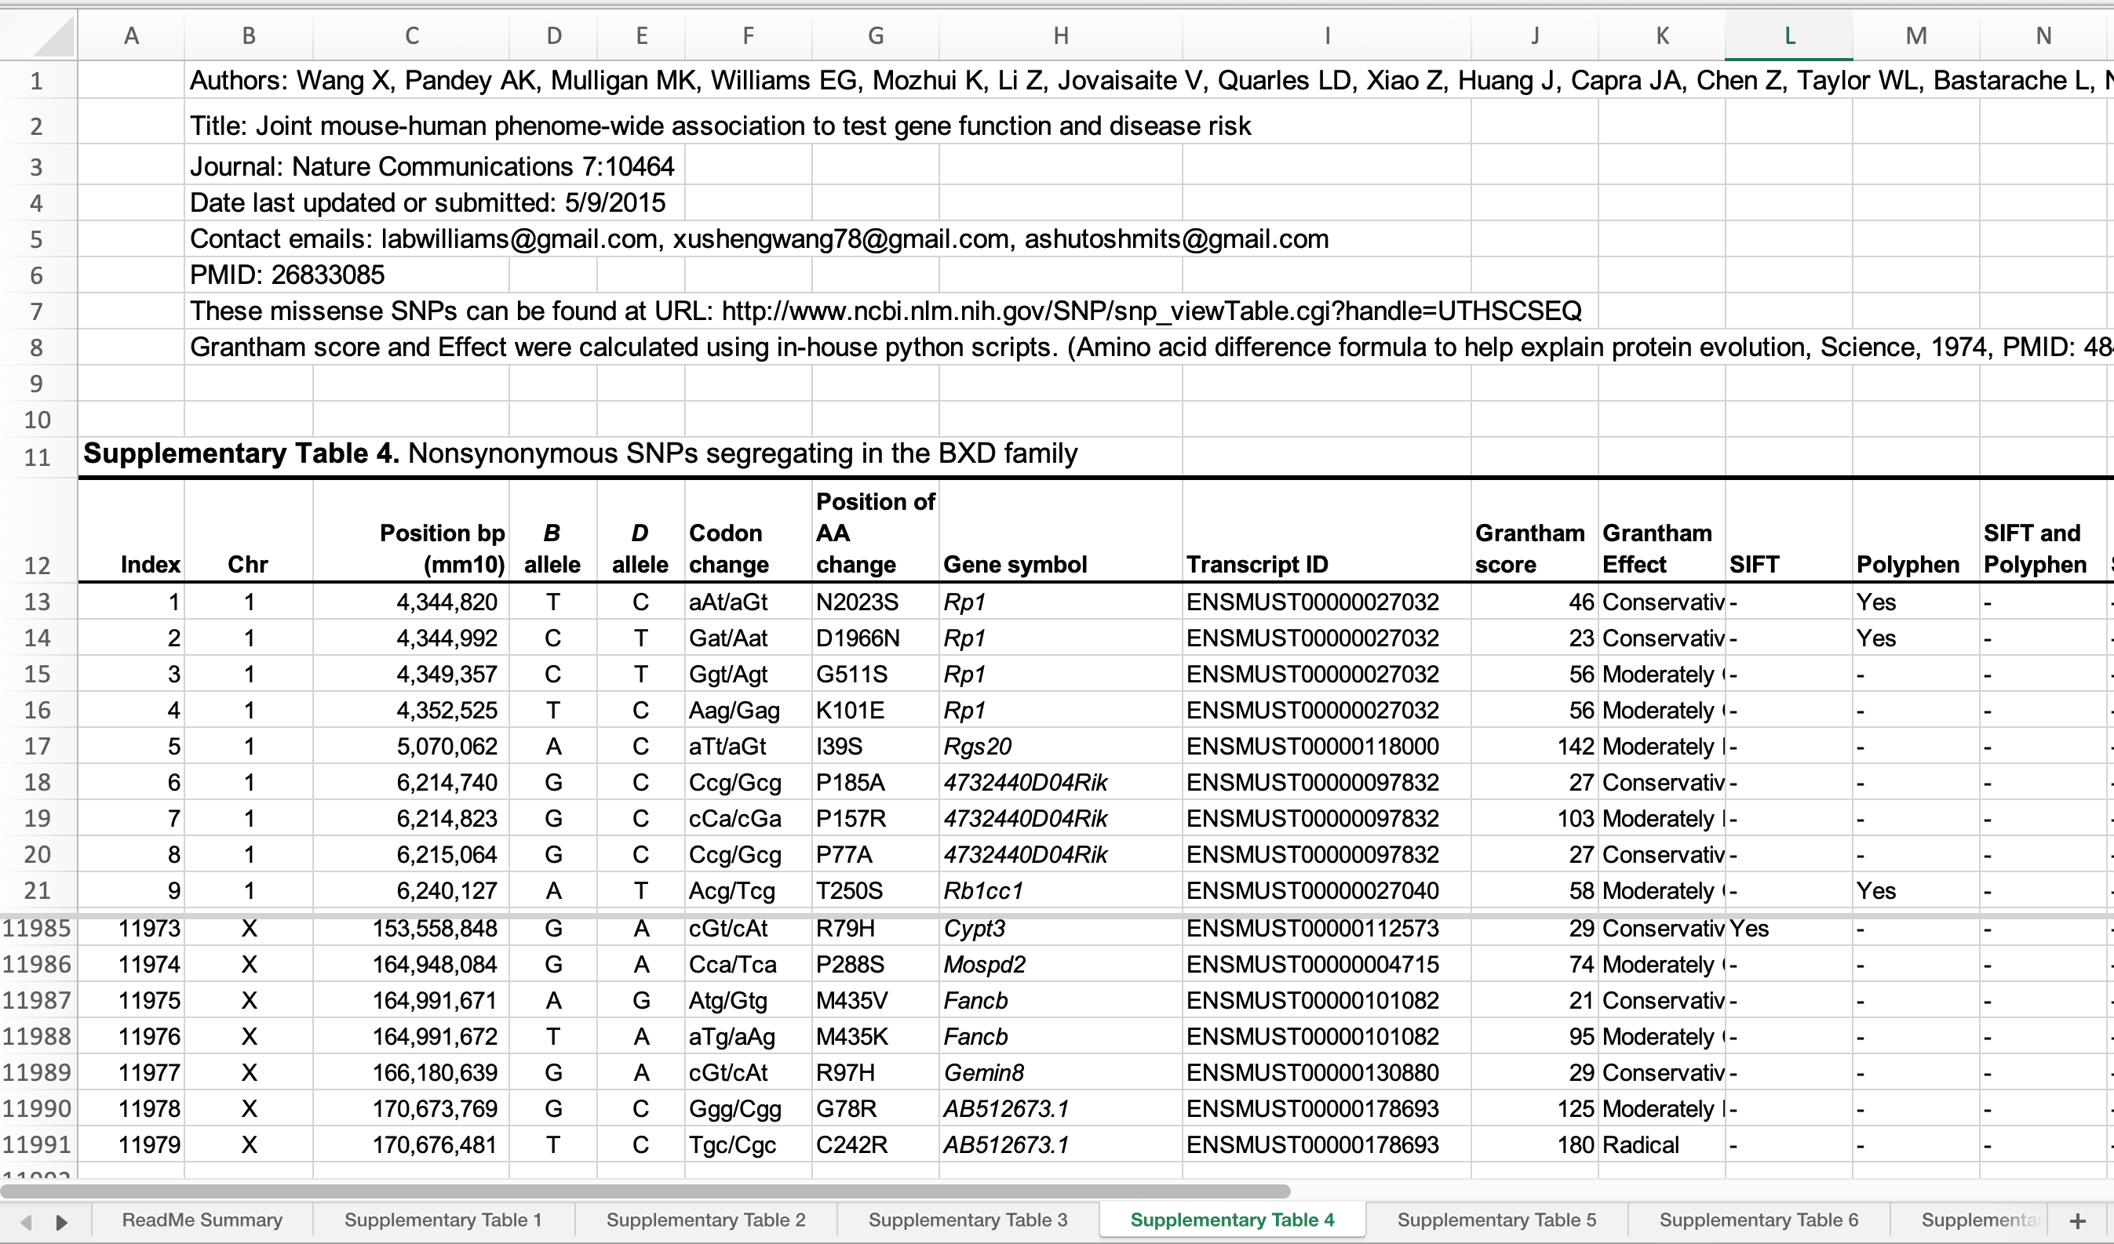
Catalog of 12,000 missense variants segregating in the BXD family
This is now practical for HXB/BXH rat family and will soon be possible using HRDP.
Here are about ~12,000 missense mutations segregating in the BXDs in 2015.
Part 4: Slide 20 (show Supplement table 4 live from Wang et al. 2016)

Slide 21
Interlude: a set of ~20 identified genes
Pum2 for control of translation (Journal of Cellular Physiology, Scott RE et al 2005, PMID: 15617101)
Igpp2 and Irgb10 for Chlamydial infection (Journal of Immunology, Miyari I et al 2007, PMID: 17641048, PMID: 22438999)
Fmn2 for control of tRNA synthases in brain (PLoS Genetics, Mozhui et al 2008, PMID: 19008955)
Ubp1 for blood pressure (PLoS Genetics, Koutnikova et al 2009, PMID: 19662162)
Comt for drug responses (PLoS One, Li, Mulligan et al 2010, PMID: 20808911)
Typr1 and Gpnmb for ocular phenotypes (Molecular Vision, Lu et al 2011)
Alpl for bone metabolism (Cell, Andreux et al 2012, PMID: 22939713)
Gabra2 for gene expression control and behavior (PLoS One and in submission, Mulligan et al 2012, PMID: 22506031 and Mulligan et al., 2019 in press)
Mrps5 for longevity and cognitive decline (Nature, Houtkooper et al 2013, PMID: 23698443)
Klrd1 for immune function (G3, Shin et al 2014, PMID: 25520036)
Ahr for locomotor active (PLoS Genetics, Williams EG et al 2014, PMID: 25255223)
Hp1bp3 and Mrp gene family for cognitive aging (Neurobiology of Aging, Neuner et al 2016, PMID: 27460150; Frontiers in Genetics, PMID: 28983317)
Dhtkd1 for metabolism (Cell, Wu et al 2014, PMID: 25215496)
D2hgdh for causal d-2-hydroxyglutaric acid metabolite effect (Science, Williams et al 2016, PMID: 27284200)
Mlycd for causal C3-dicarboxylcarnitine metabolite effect (unpublished, Houten et al)
Taar1 for methamphetamine addiction (PLoS One, Shi et al 2016, PMID: 27031617)
Echdc1 and Mmab for cholesterol metabolism (Science, Williams EG et al 2016, PMID: 27284200)
Bckdha, Bckdhb, and Cox7a2l for amino acid degradation pathways and mitochondrial function (Science, Williams EG et al 2016, PMID: 27284200)
Cacna2d1 for intraocular pressure (Nature Communications, Chintalapudi et al 2017, PMID: 29176626)
Atf4 and Fh1 for mitochondrial stress (Journal of Cell Biology, Quiros et al 2017, PMID: 28566324)
docs.google.com/document/d/1nZJydWEcFQSYdTcZwk_xwoxMjNVL_Ej9bLNEEbANkxs/edit
Part 4: Slide 21 Hits as of 2017

Slide 22
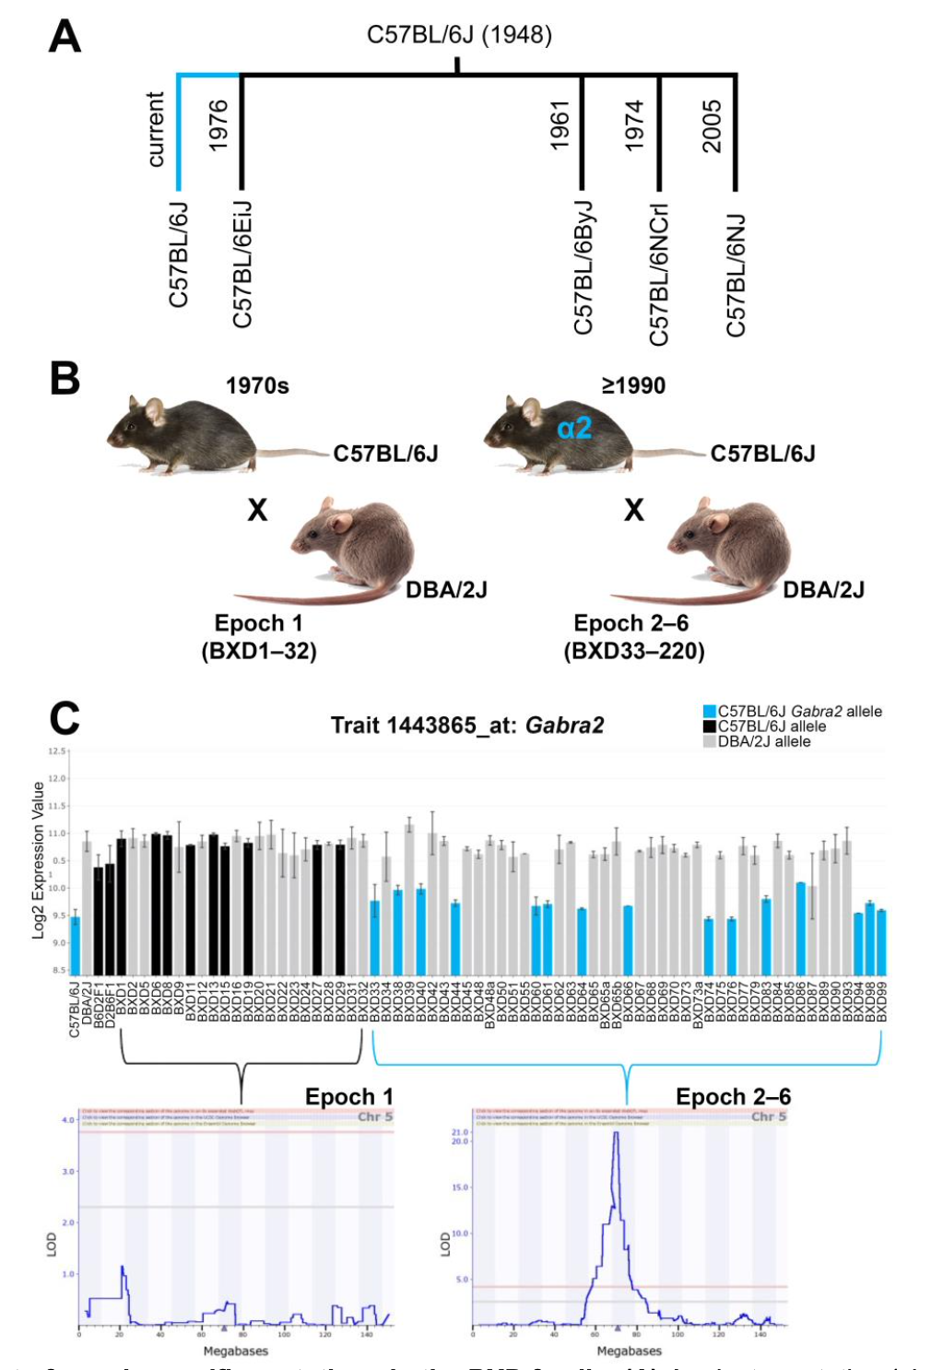
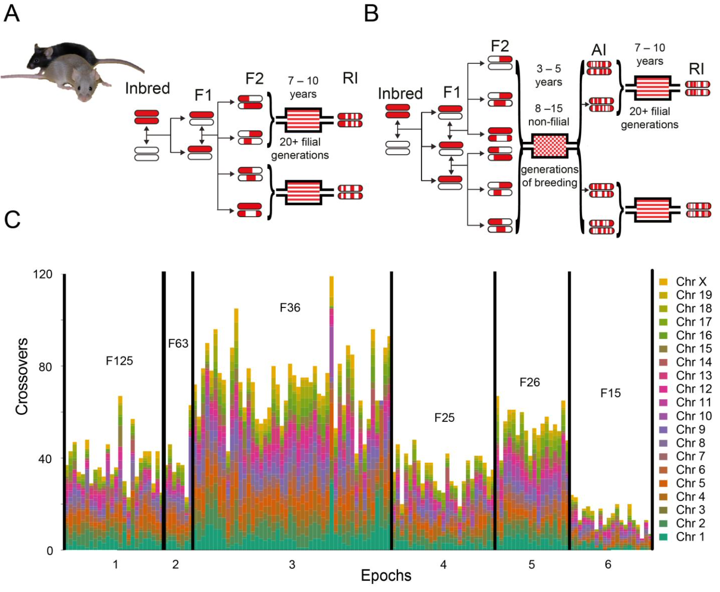
Epoch effects: A great resource rather than a nuisance (David Ashbrook)
Part 4: Slide 22 Epoch effect

Slide 23
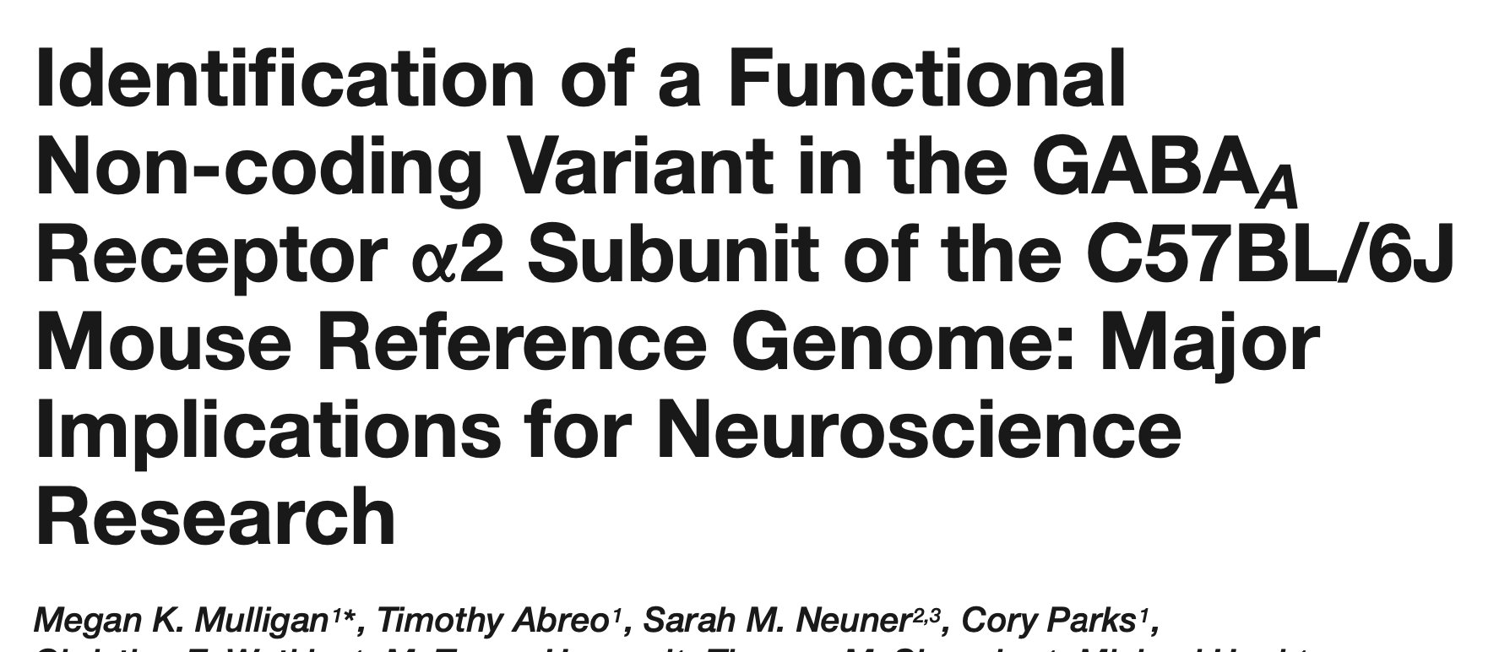
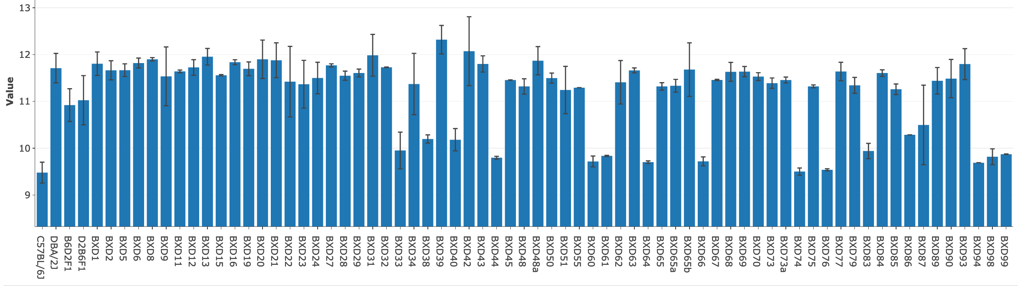
Epoch effects and Gabra2 (Mulligan and team)
genenetwork.org/show_trait?trait_id=1443865_at&dataset=HC_M2_0606_P
An “epoch effect” is due to fixed spontaneous mutations that occurs in one of the parental strains between epochs.
This is a new mutation after 1990
Not segregating in first set
Segregating in late Taylor and UTHSC sets
Part 4: Slide 23 A hybrid method to define DNA variants (forward) and to downstream phenotypes (reverse)

Slide 24
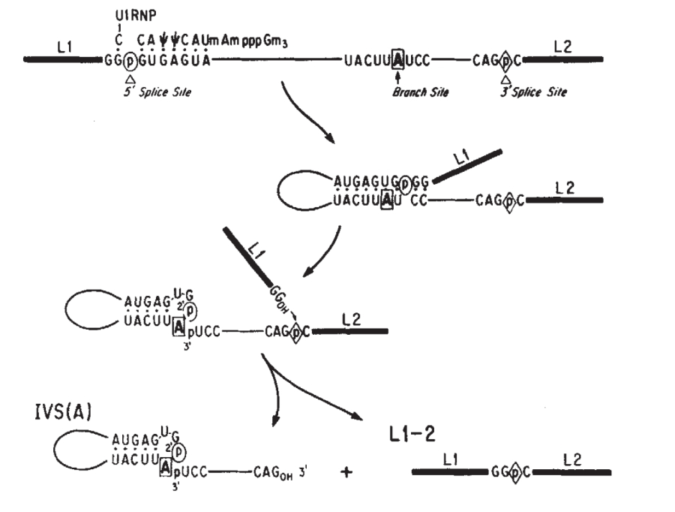
Sequencing of original B haplotype and new mutant B haplotype
Four putative variants but only one that was a strong contender—a 1 nt deletion adjacent to the exon 5 splice acceptor site.
Intergenic SNP
UTHSC, SANGER, traditional
Conserved
Intronic deletion
UTHSC, SANGER, traditional
Conserved; splice region variant
Intronic insertion
UTHSC, SANGER, traditional
Not conserved
Intronic insertion
UTHSC, SANGER
Weak conservation
Part 4: Slide 24 The causal variant
Notes:
Purine = A and G (Double Ring)
Pyrimidine = T, U, and C (Single Ring)

Slide 25
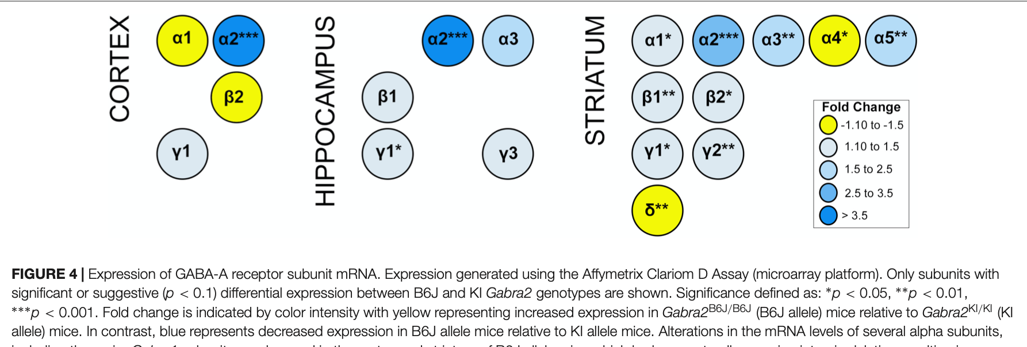
Why is this mutation valuable? (Mulligan and team)
Now possible to make a reduced complex cross between B6J (the mutant) and B6N (the wildtype) and evaluate linkage of gene expression (compensatory changes in expression of other GABA-A receptors), behavior, and drug phenotypes to this Gabra2—the only functional polymorphism in this region.
What is a reduced complexity cross?
It is a new post-genomic cross type that requires full genome sequence for two very closely related substrains—for example C57BL/6J and C57BL/6NJ.
First used by Glenn Rosen, Megan Mulligan, and Vivek Kumar. An RCC was used by Kumar, Takahashi and colleagues to prove Cyfip2 is involved in cocaine response.
Kumar V et al. (2013) C57BL/6N mutation in Cytoplasmic FMRP interacting protein 2 regulates cocaine response. Science 342: 1508
Part 4: Slide 25 The molecular cascade

Slide 26
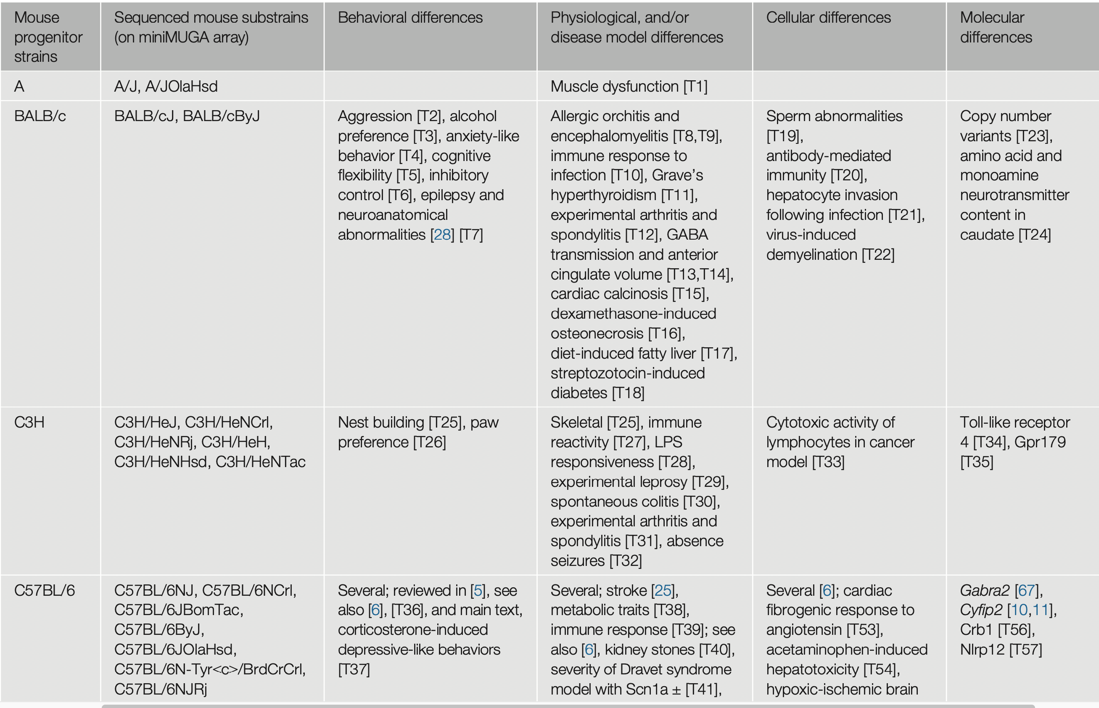
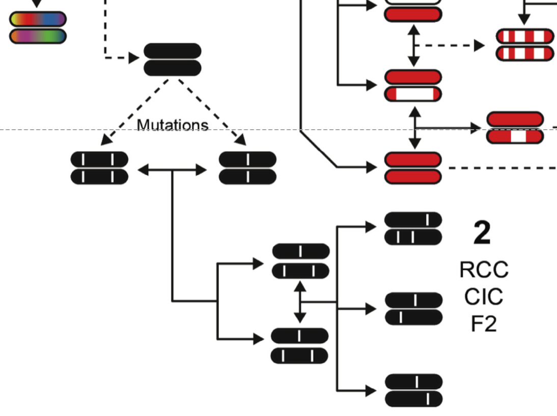
The reduced complexity cross as a hybrid method
RCC is a post-genomic hybrid G2P method.
Why? In order to map an RCC you need to find 100+ very rare spontaneous mutations that distinguish pairs of substrains that you can use as markers for “classic” mapping of the RCC.
Trends in Genetics 2020
Part 4: Slide 26

Slide 27
Some conclusions and suggestions
1. Most forward genetic studies of complex traits should aim to identify highy plausible gene variants using a variety of complementary resources. Obsessing about precision using one type of resource and one species is harder than using a variety of resources. Despirt this advice this is staill an uncommon approach.
2. Trying to identify the causal DNA variants is often not justifieds. Are you actually interested in mutation types and rate and their impact on phenotypes more generally? Usually not. While we know the precise cause of the Comt mutation that affects CNS monaminergic systems, this does not buy us much translational utility other than to be on the lookout in humans for mobile element polymorphisms in 3’ UTRs that alter polyadenylation and therefore the metabolism and transport of mRNAs.
3. The most effective current methods to identify and QTL genes are often hybrids of forward and reverse genetic methods—now made possible by full genome sequencing. The Comt example ws actually catalyzed by a puzling cis eQTL that “should not have been”. The Gabra2 variant in C57BL/6J is an even better illustration that also highlights the value of eQTL data.
4. Take advantage of earlier studies and findings that interest you scientifically. These studies can often be reanalyzed/resuscitated using advanced genomics resources and high density marker maps.
Slide 27

Slide 28
Questions, suggestions, ideas
From Casey
not sure on source of this rat photo
11:06:01 Arthur Centeno : The power point slides and pdf course material are now available at: http://opar.io/webinar_series_1.html
11:35:47 Joe Nadeau : By using lots of different strains and resources, is there an implicit model that the QTL has a pretty constant and consistent effect across strains and backgrounds, I.e. not much epistasis, background, or context-dependent effects? Does strong independent effects limit the scope of discovery? QTLs whose action across backgrounds are of course pretty interesting. But the others are interesting too. It’s probably important to understand the the strengths and limits of the underlying model that’s being tested.
REPLY RWW: Yes, great point. This is even true within single complex crosses such as CC, DO, and HS were haplotype contrasts are an important part of mapping. If independent allele/haplotype effects have overlapping and opposite polarities, then they may fail to be detected using simple methods (e.g. only SNP genotypes rather than haplotypes). It is possible make the combination of resource types much easier by using complementary resources that segregated for the same haplotypes—e.g. an A/B F2 and A/B advanced intercross, A/B RI family and A/B RIX diallel, and the pair of A/B consomic and congenics.
11:41:25 From Camron Bryant : Don't tell people at your chalk talk that you don't need the nucleotide variant - you will not get the job.
11:42:20 From Saunak Sen : :)
11:59:47 From Camron Bryant : gotta go, sorry i couldn't be there for RCCs!
REPLY RWW: Presentation and Q&A recorded. Will be linked at opar.io soon
Slide 28. End
rwilliams@uthsc.edu

Slide 29
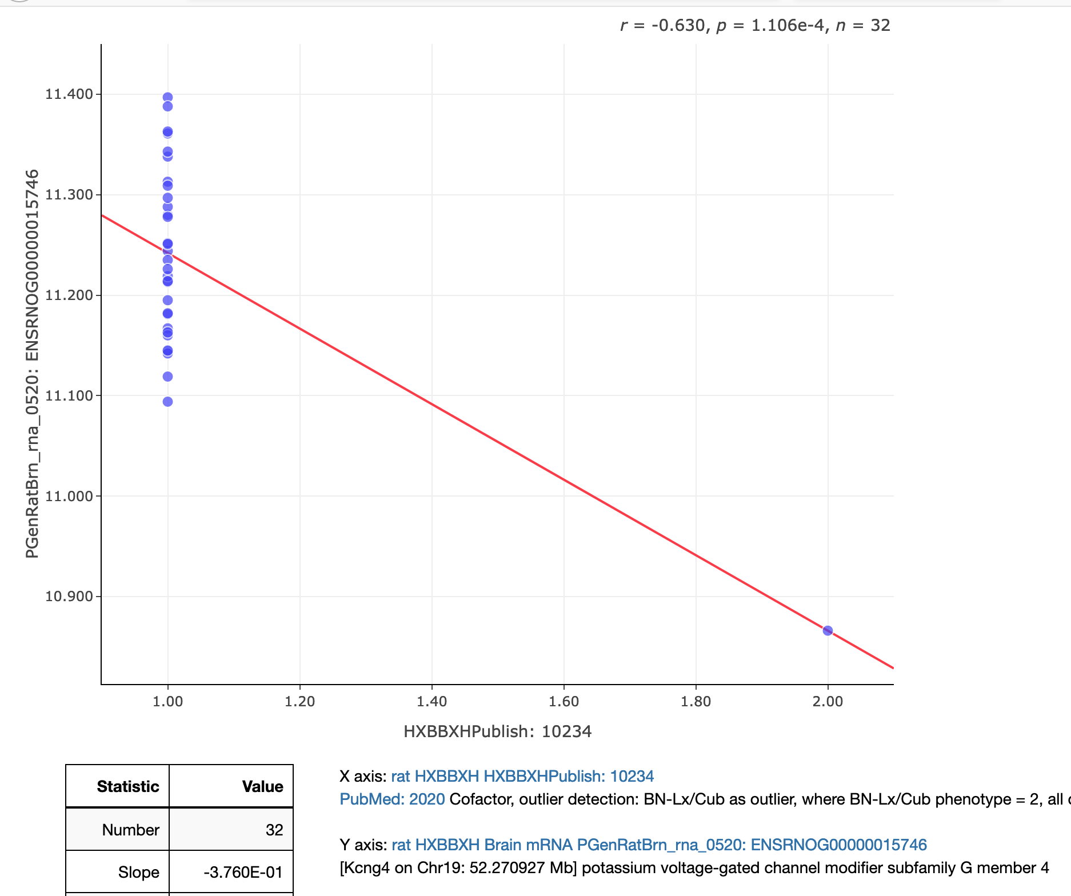
Time permitting: Cherry picking cases and rare mutations in HRDP and HMDP
We now have sequence data for the HXB, FXLE, and the eight parents of the HS rats. We have sequence data for BXD, CC, and about 25 other strains of mice. All traits will be remappable on the new assemblies and with comprehensive ”overlay” tracks of sequence variants and haplotypes in every locus.
Almost all rare variants willo be known and potentially usable for reverse genetics provided we have a deep phenome for the relevant strains. That is where the mouse and rat phenome projects become critical.
That is also why it is critical to use common rodent resources,
Part 5: Slide 29 Live demo if possible. How to cherry pick strains or cases

Slide 30
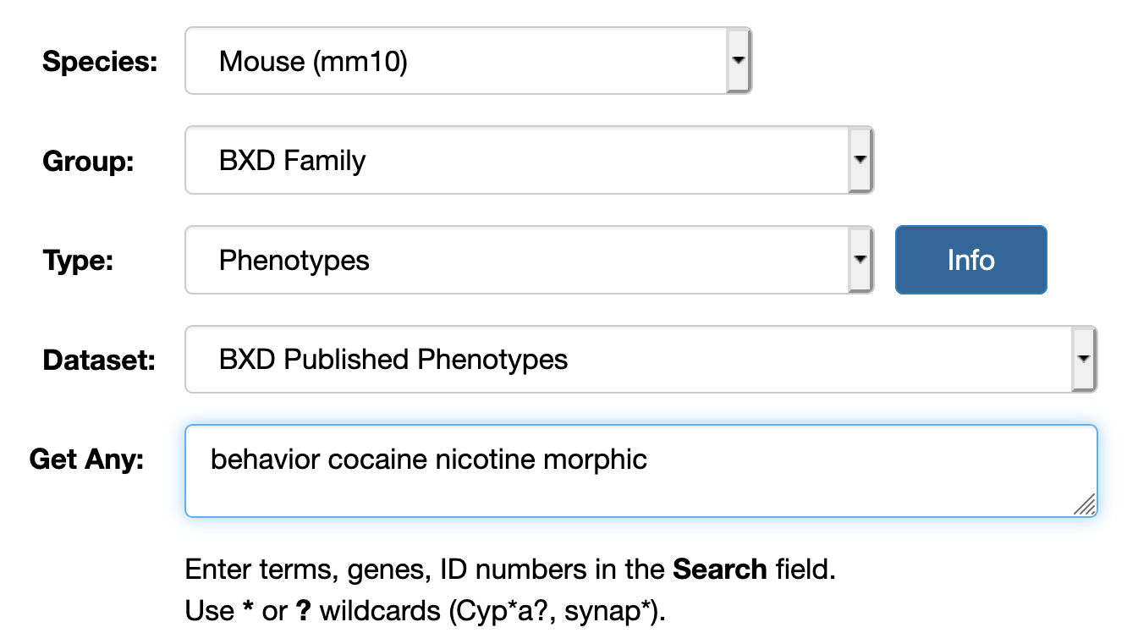
Time permitting: Cherry picking traits and QTLs
Part 5: Slide 30 Live demo on how to pick traits based on linkage or location

